Slide 1
Pyspark module-7

Slide 2
Pyspark | Performance Optimization - Bucketing

Slide 3
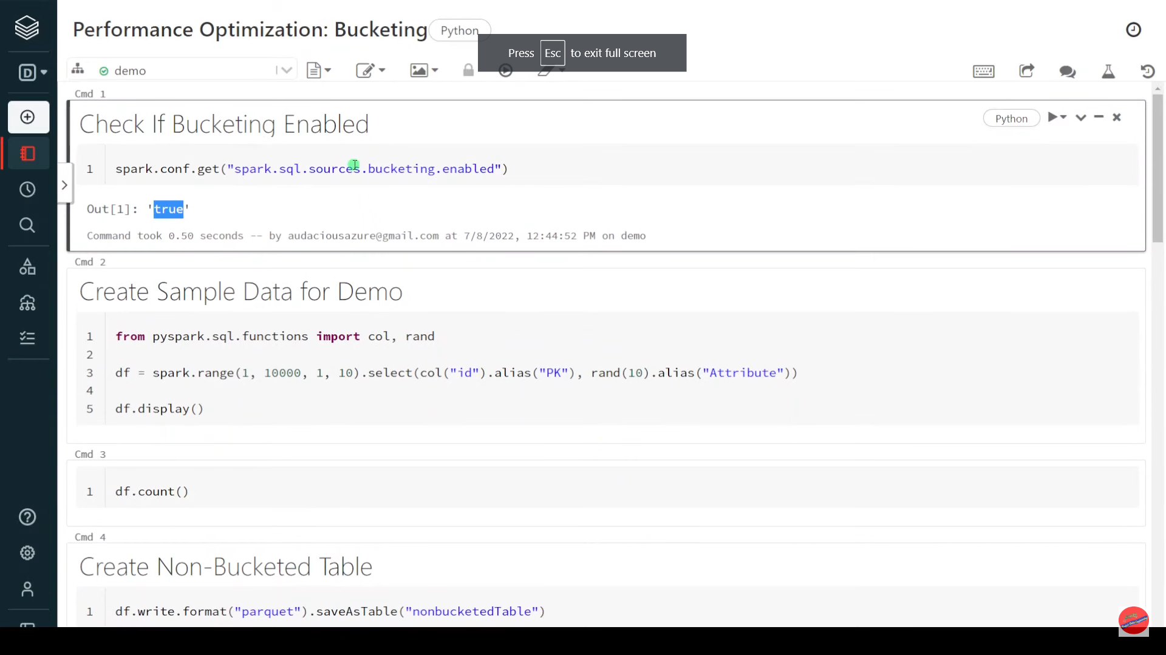

Slide 4
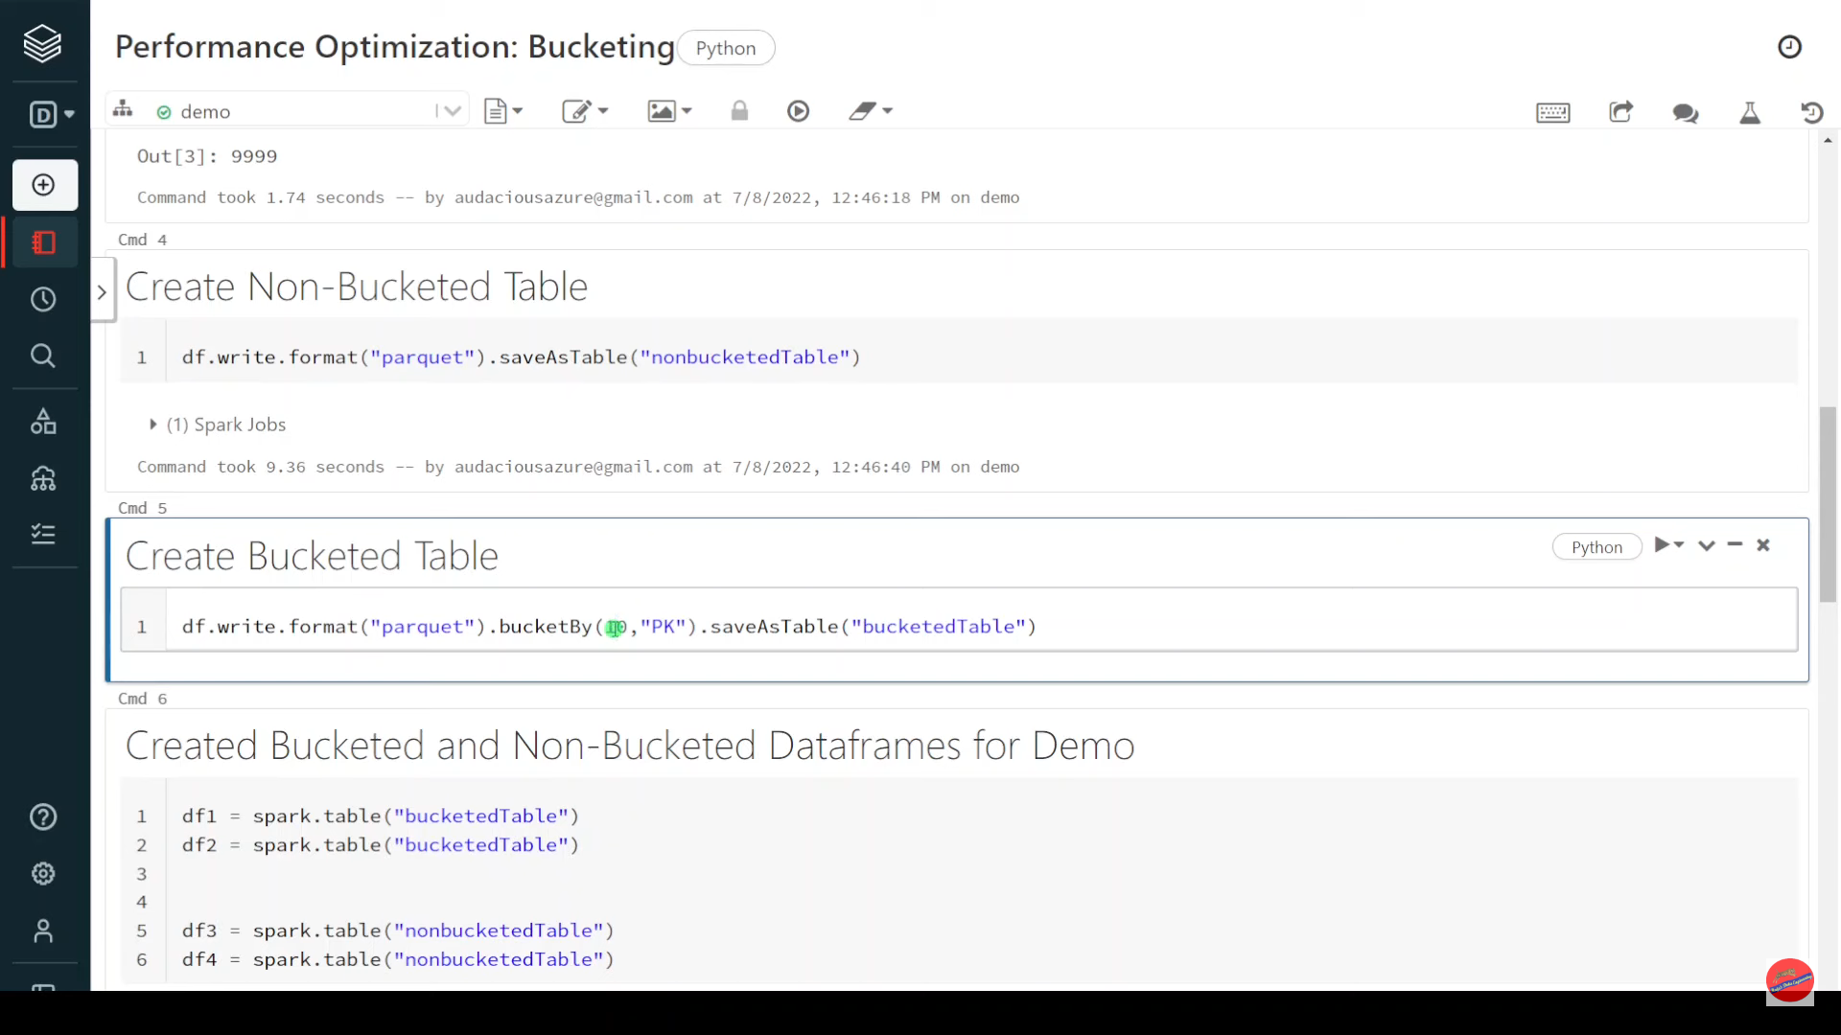

Slide 5
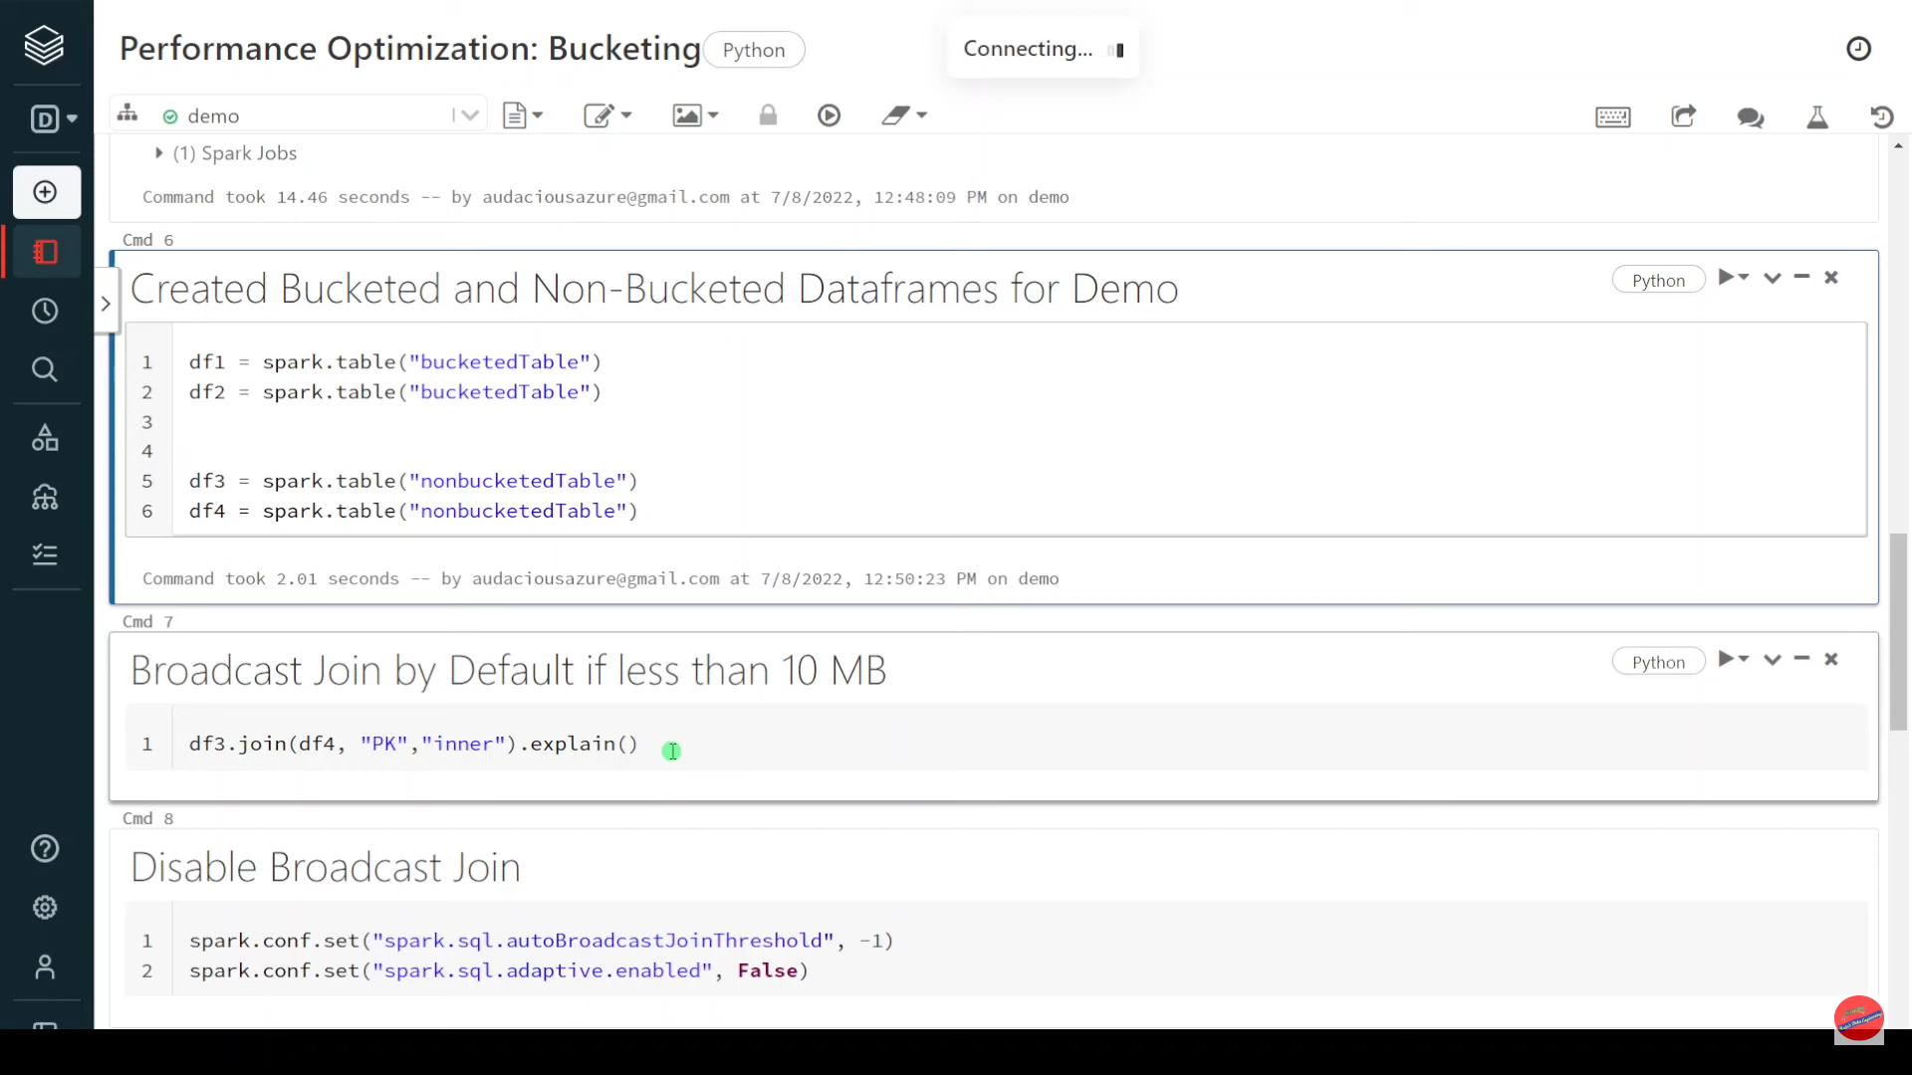

Slide 6
Databricks|Pyspark:Interview Question|Scenario Based|Max Over () Get Max value of Duplicate Data

Slide 7
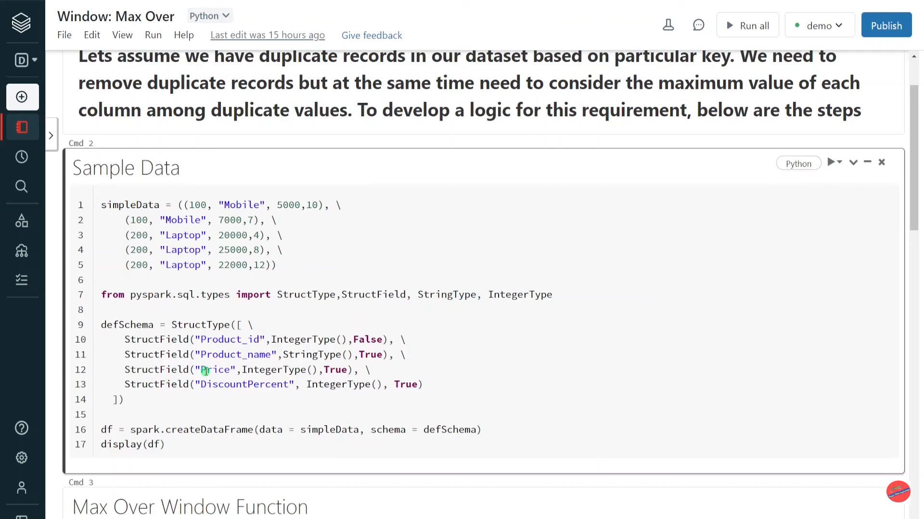

Slide 8
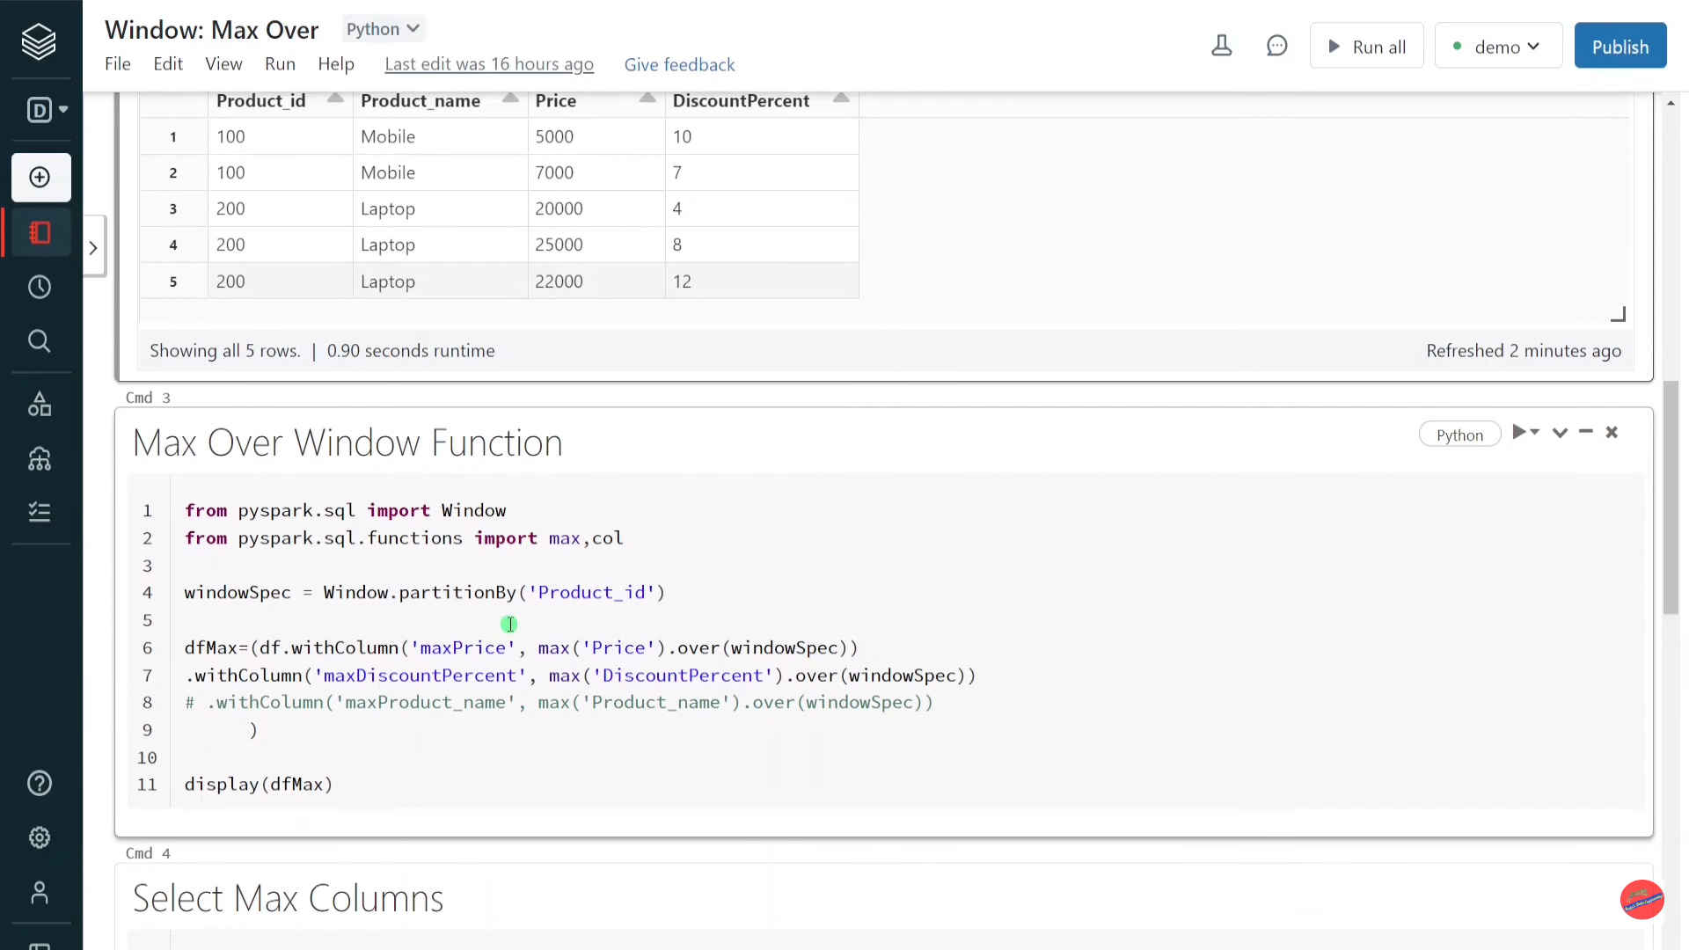

Slide 9
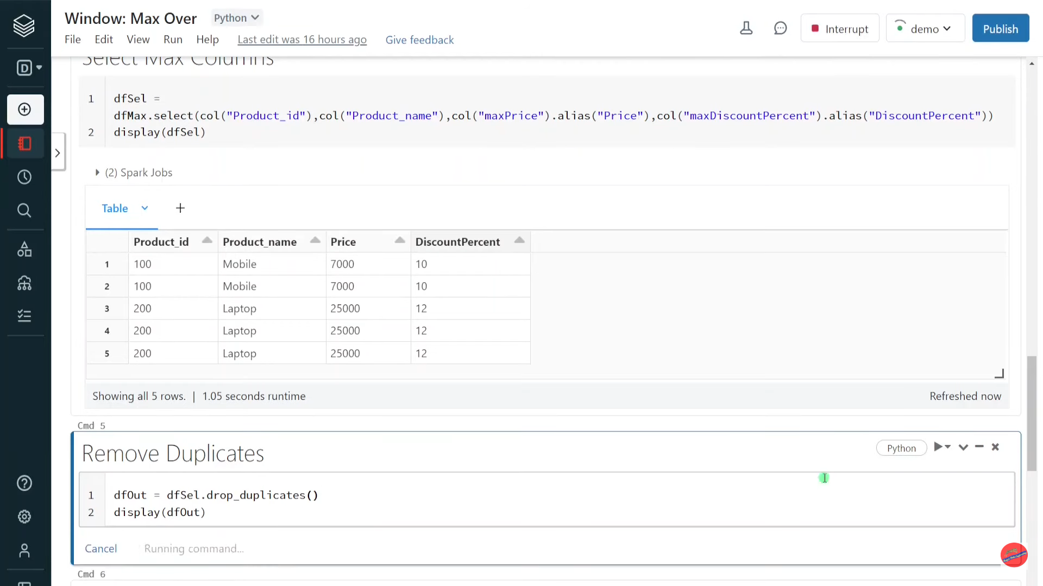

Slide 10
Pyspark | Create_map(): Convert Dataframe Columns to Dictionary (Map Type)

Slide 11
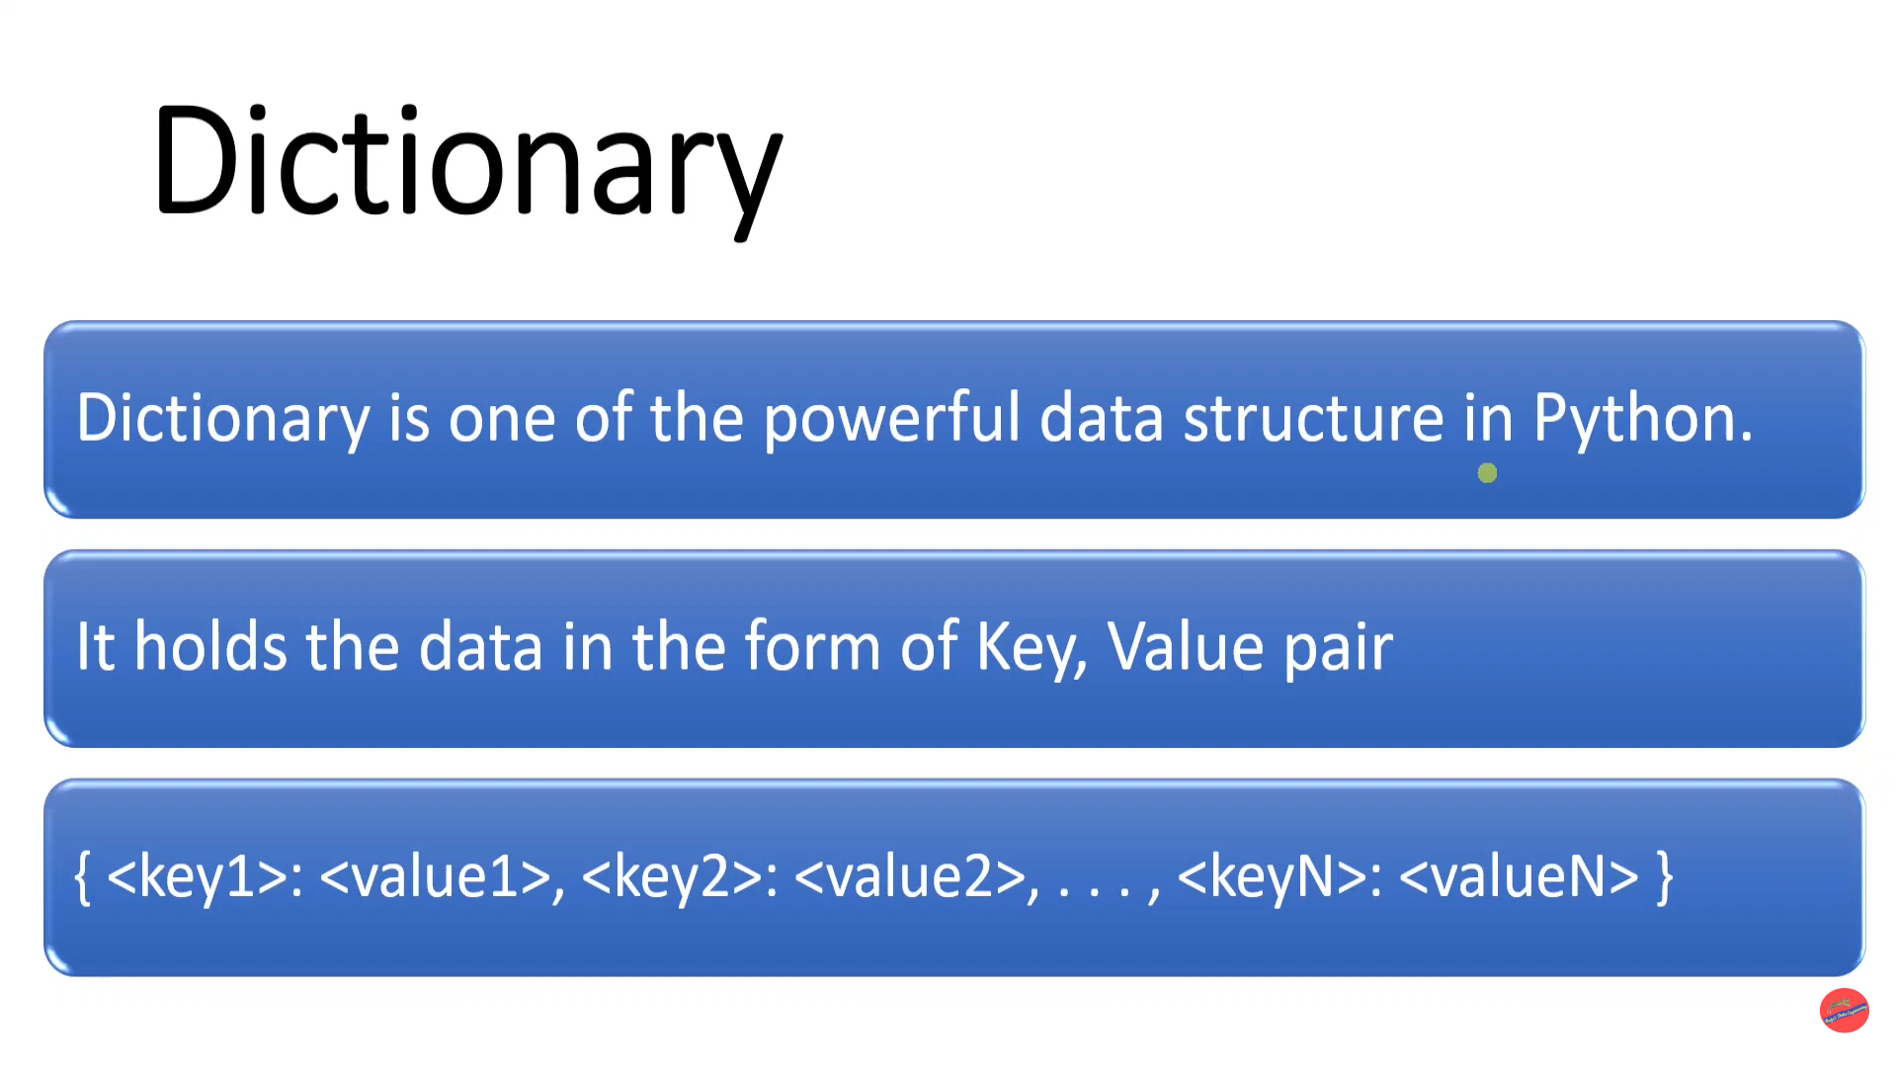

Slide 12
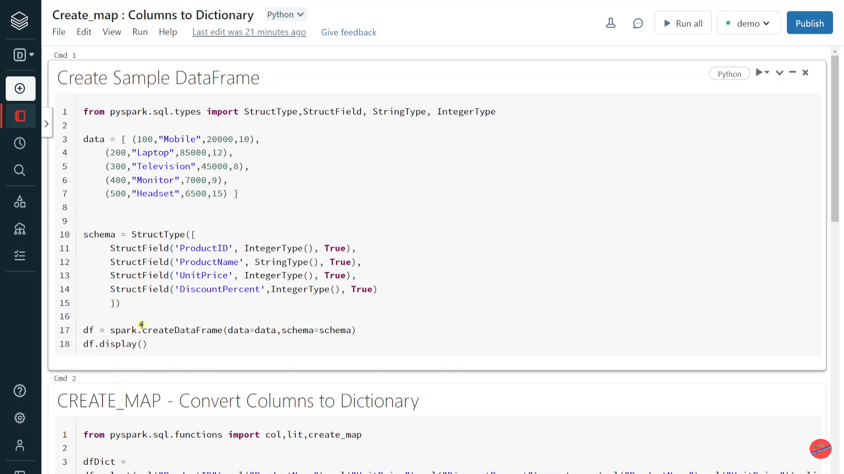

Slide 13
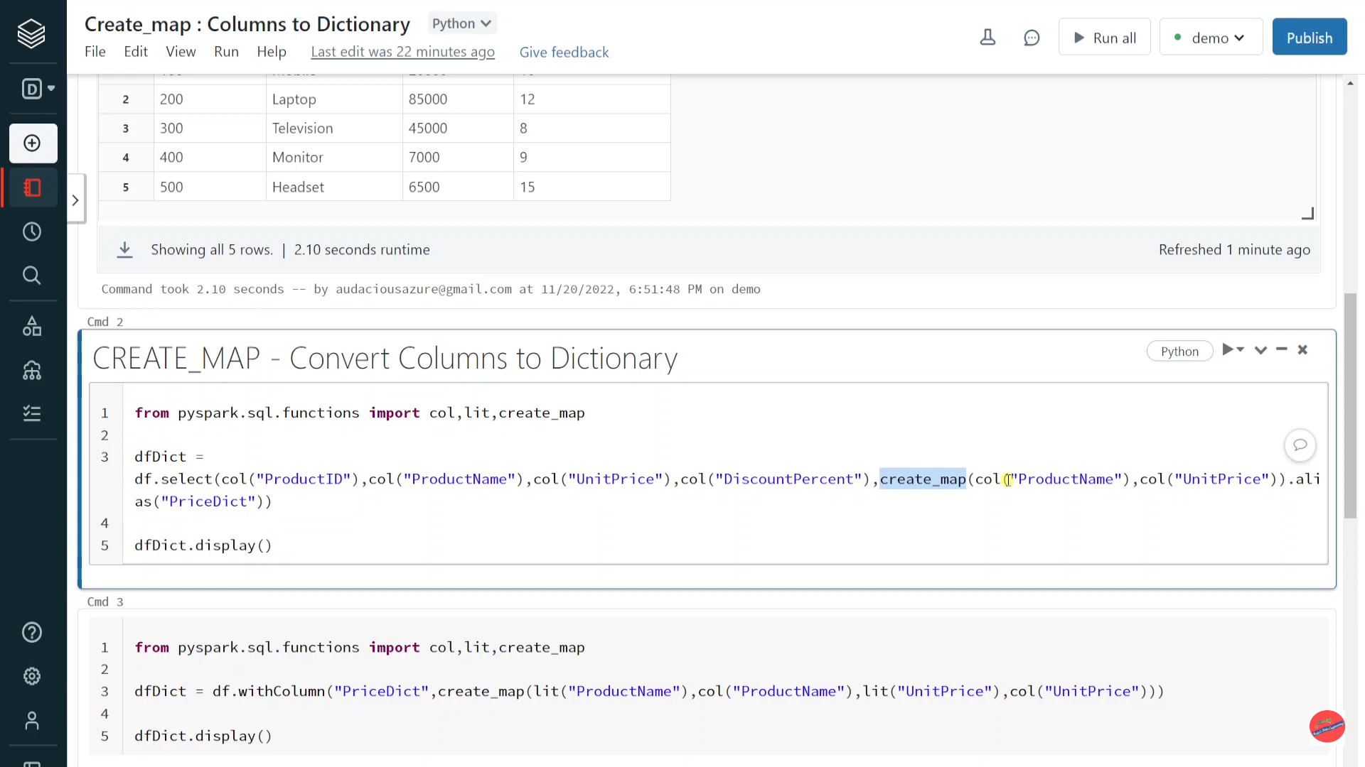

Slide 14
Pyspark | Performance Optimization: Delta Cache

Slide 15
Spark Cache vs Delta Cache
Spark cache is In-memory persist
Delta cache is disk persist

Slide 16
DBIO
DELTA
CACHE

Slide 17
How Delta Cache Works?
When delta table is queried first time, data is read from remote and also getting persisted to local disk in cluster
The subsequent reads of same data file would be prevented from remote access, as data is locally available
Delta table can be preloaded using CACHE command to speed up all further data analytics

Slide 18
How Delta Cache is faster than Spark Cache?
Efficient decompression algorithms
Optimal Data format
Delta Cache

Slide 19
Enable Delta Cache
Spark.conf.set(“spark.databricks.io.cache.enabled”,"[true | false]")

Slide 20
%sql
SELECT * from names
%sql
CACHE select * from names
%sql
SELECT * from names where year =2007

Slide 21
Pyspark | Split Array Elements into Separate Columns

Slide 22
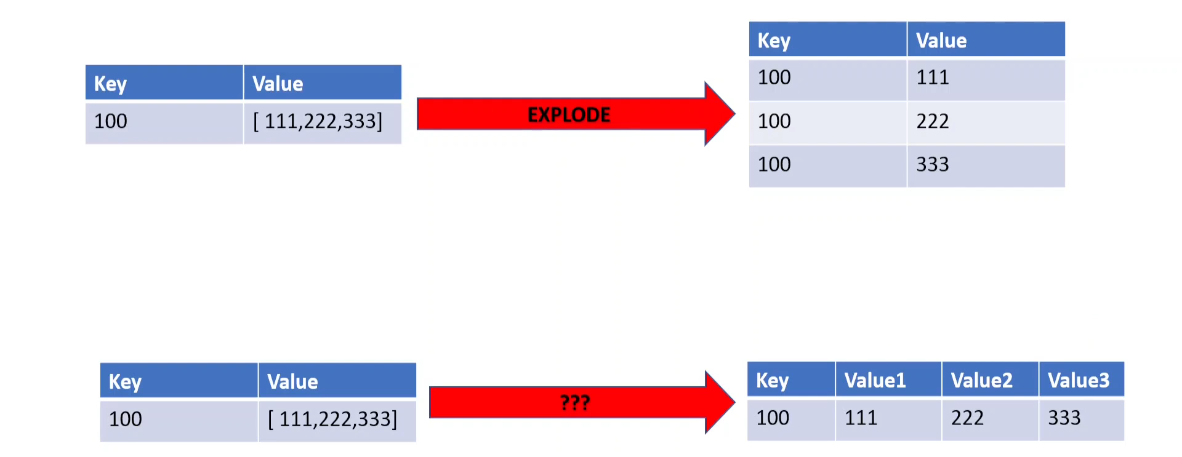

Slide 23
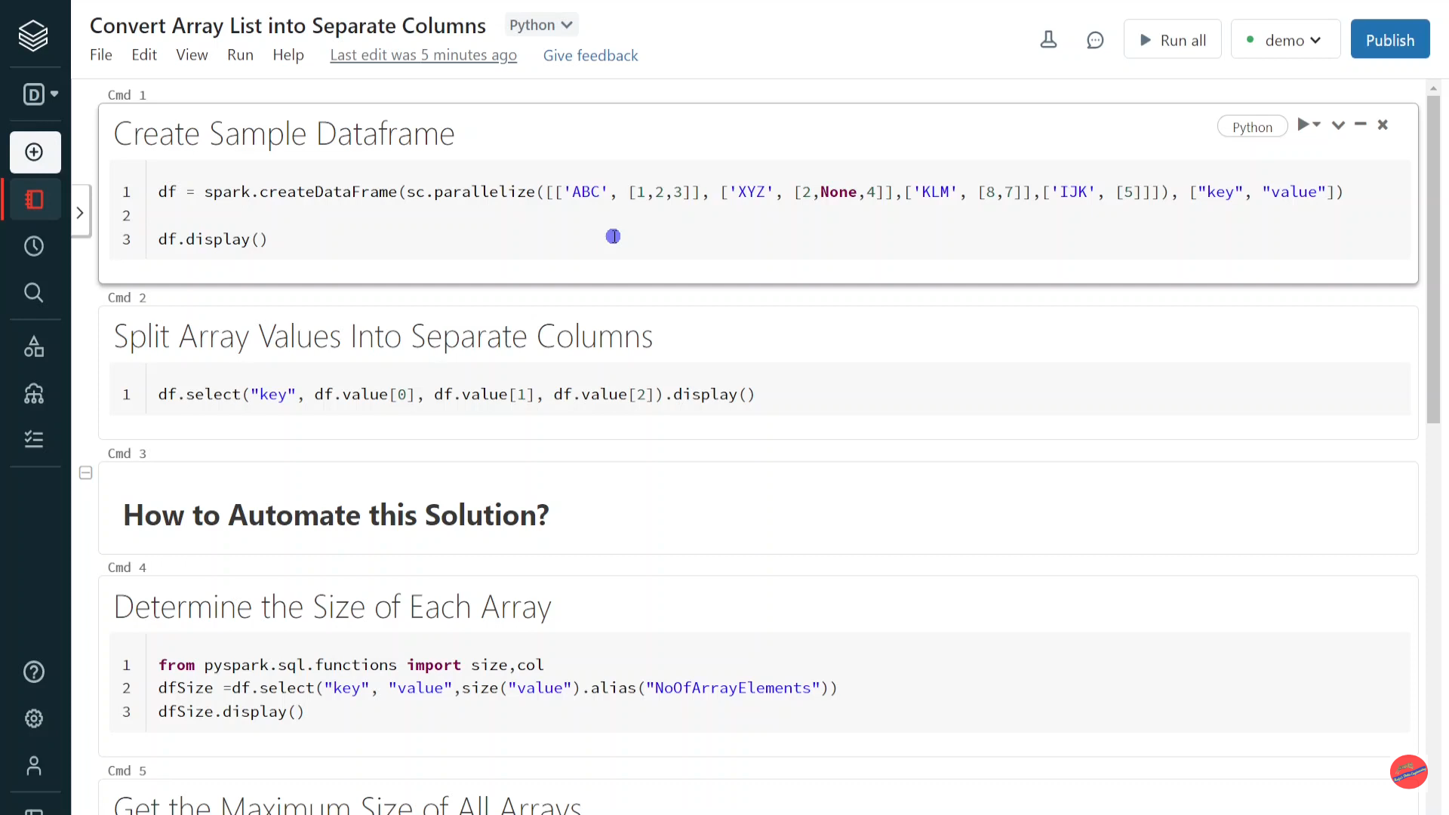

Slide 24
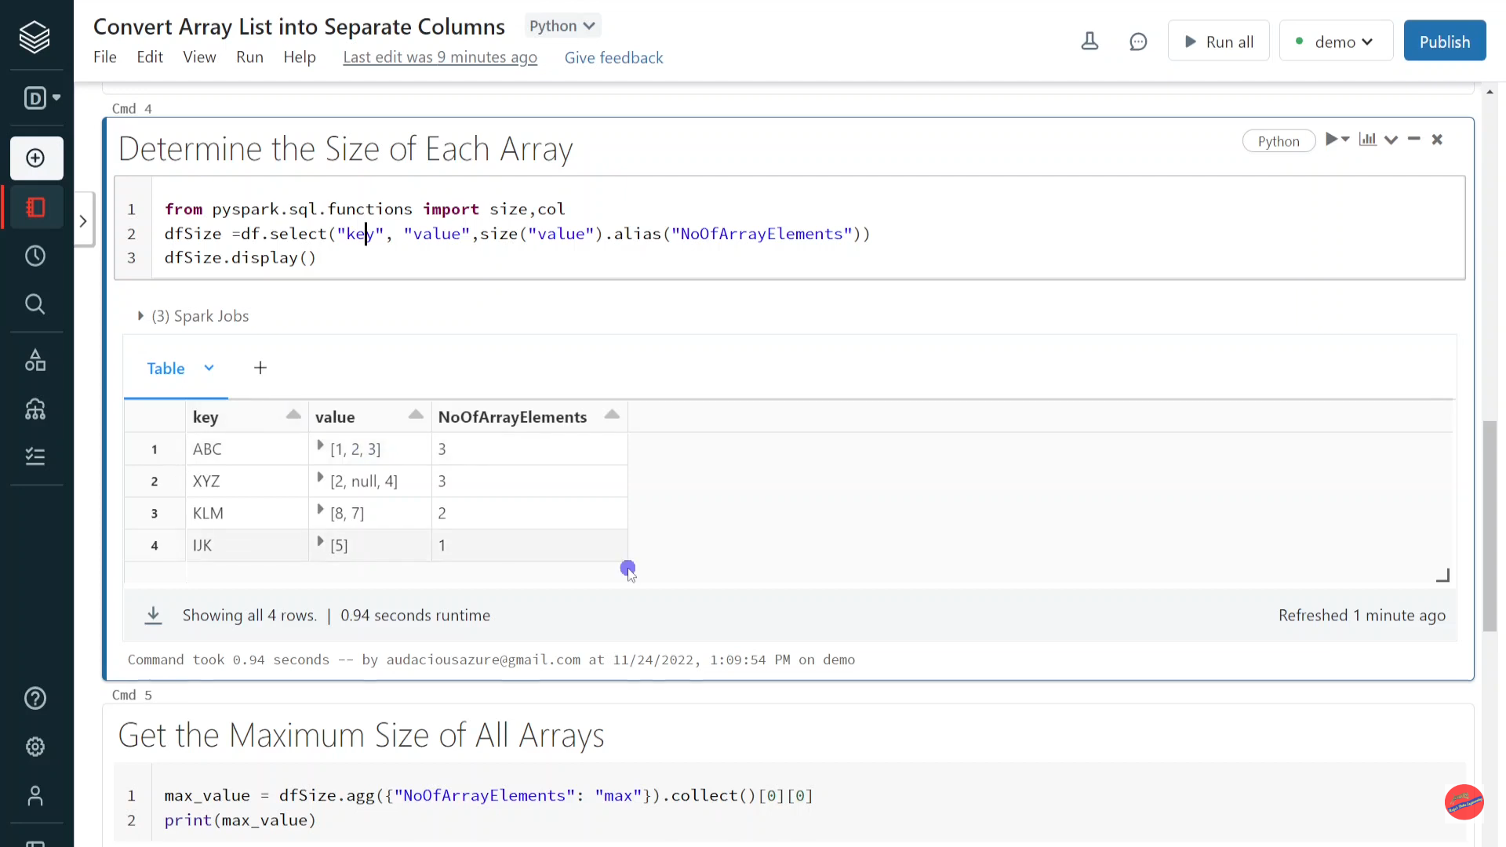

Slide 25
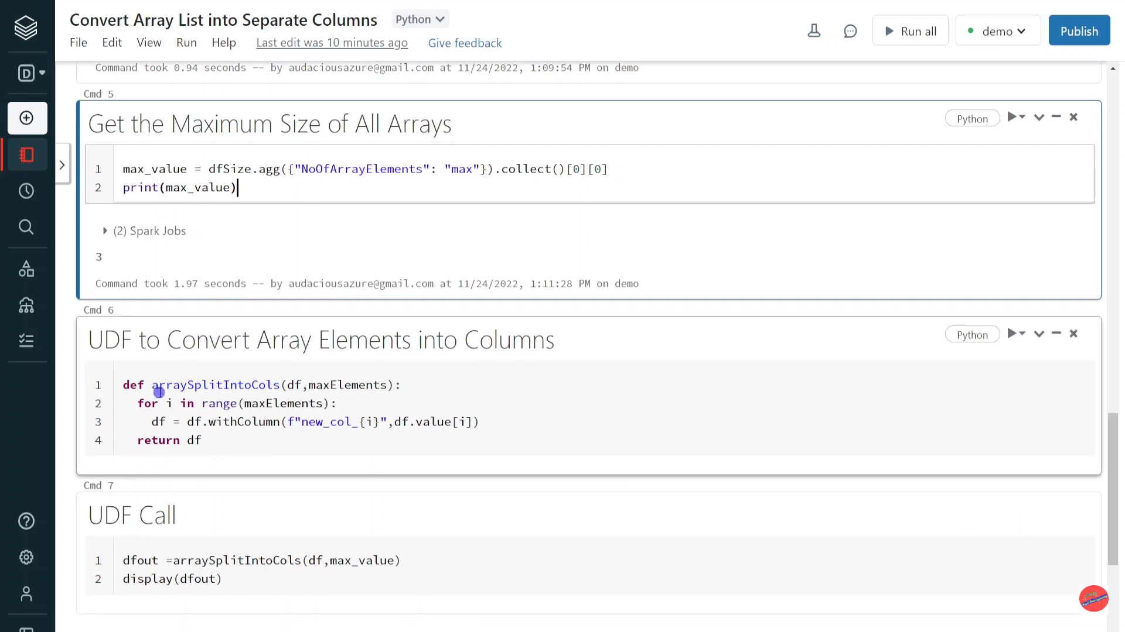

Slide 26
Pyspark | Tips: Write DataFrame into Single File with Specific File Name

Slide 27
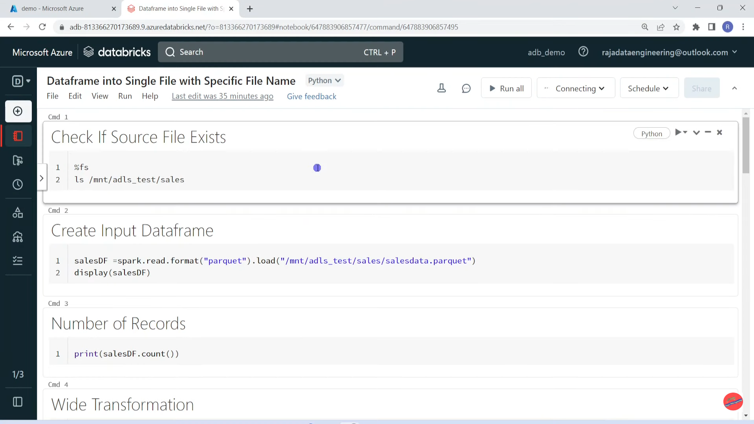

Slide 28
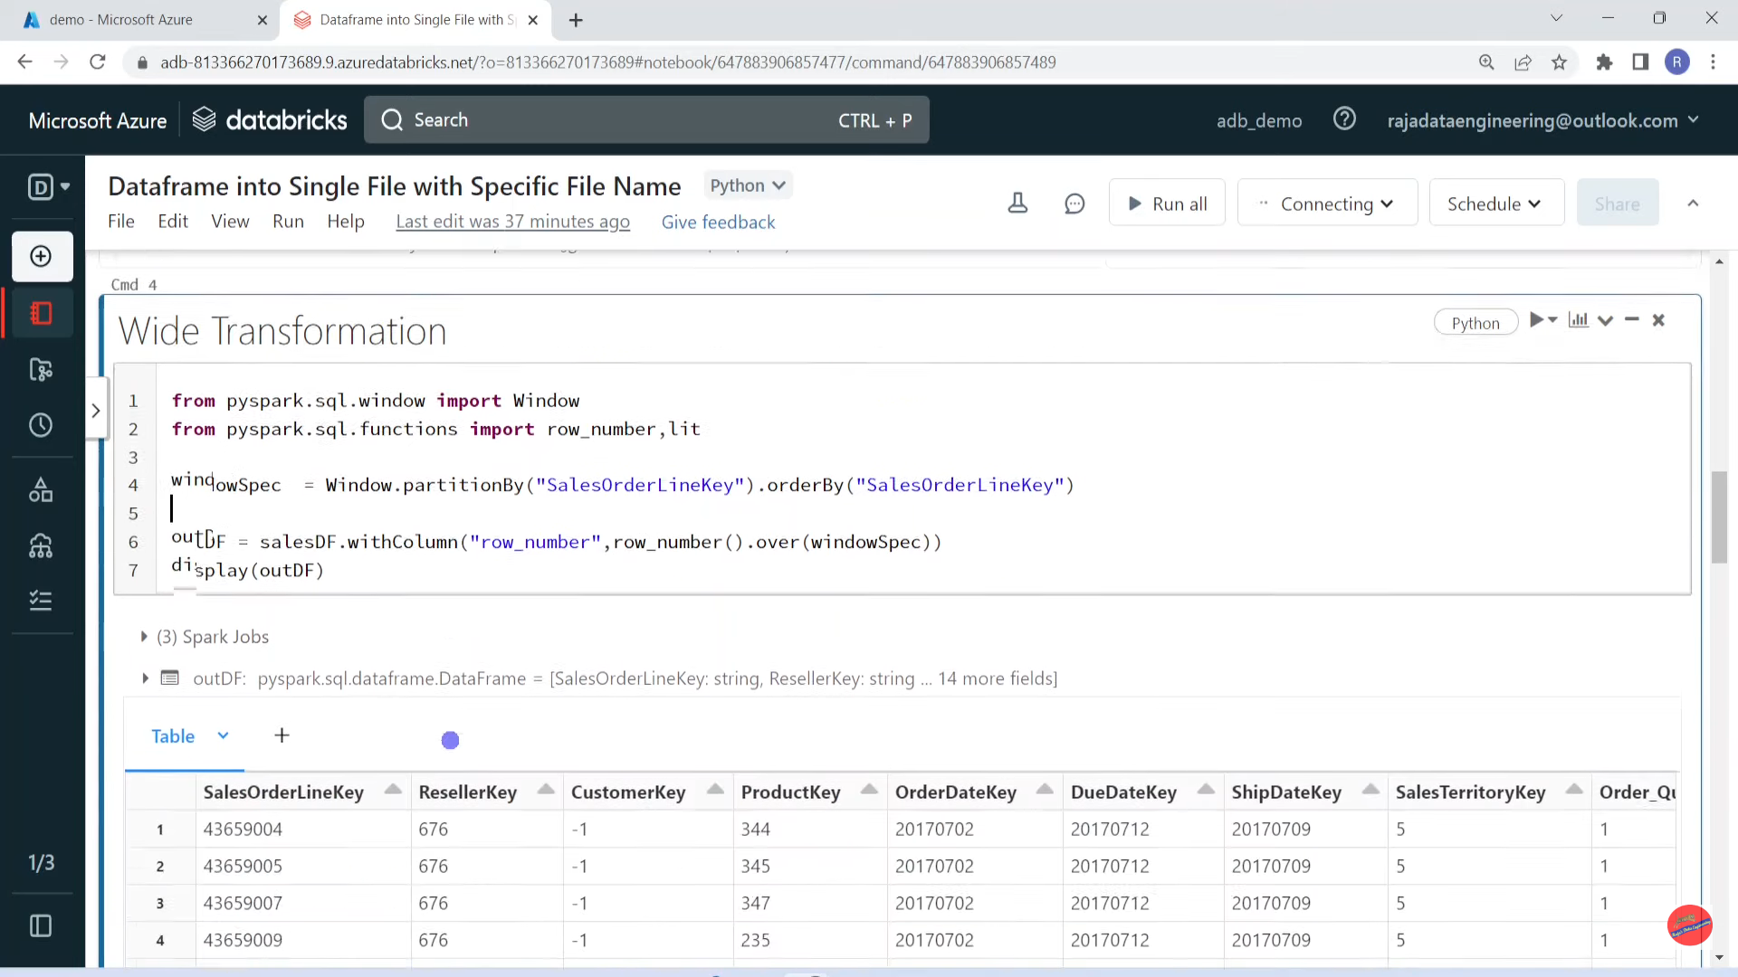

Slide 29
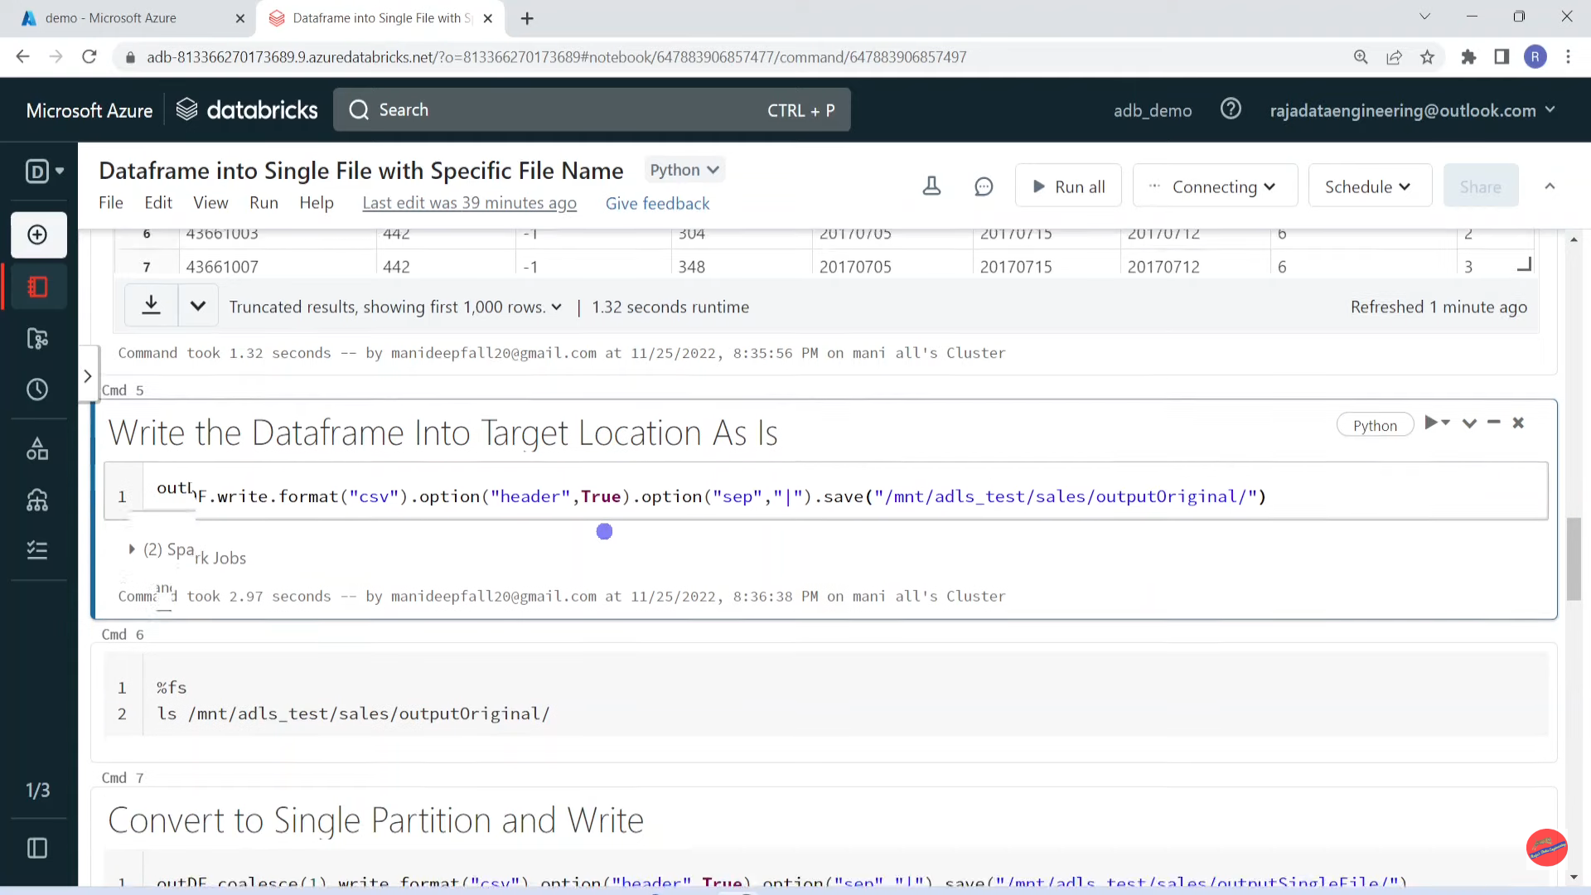

Slide 30
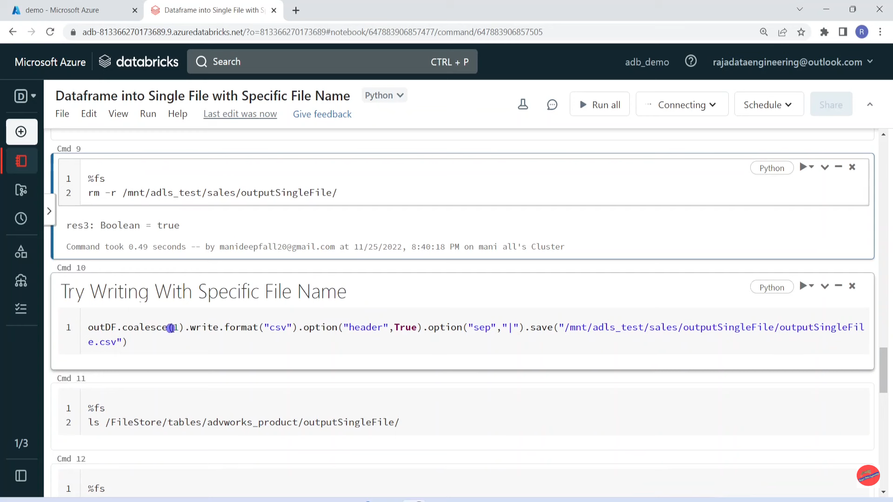

Slide 31
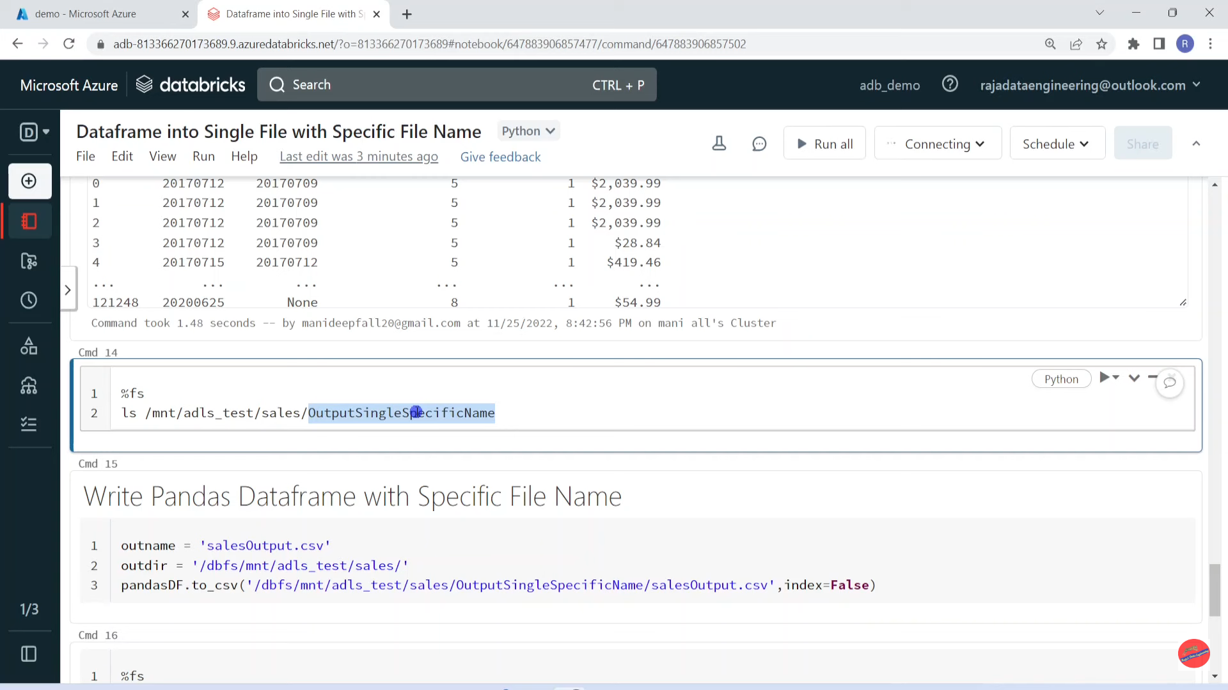

Slide 32
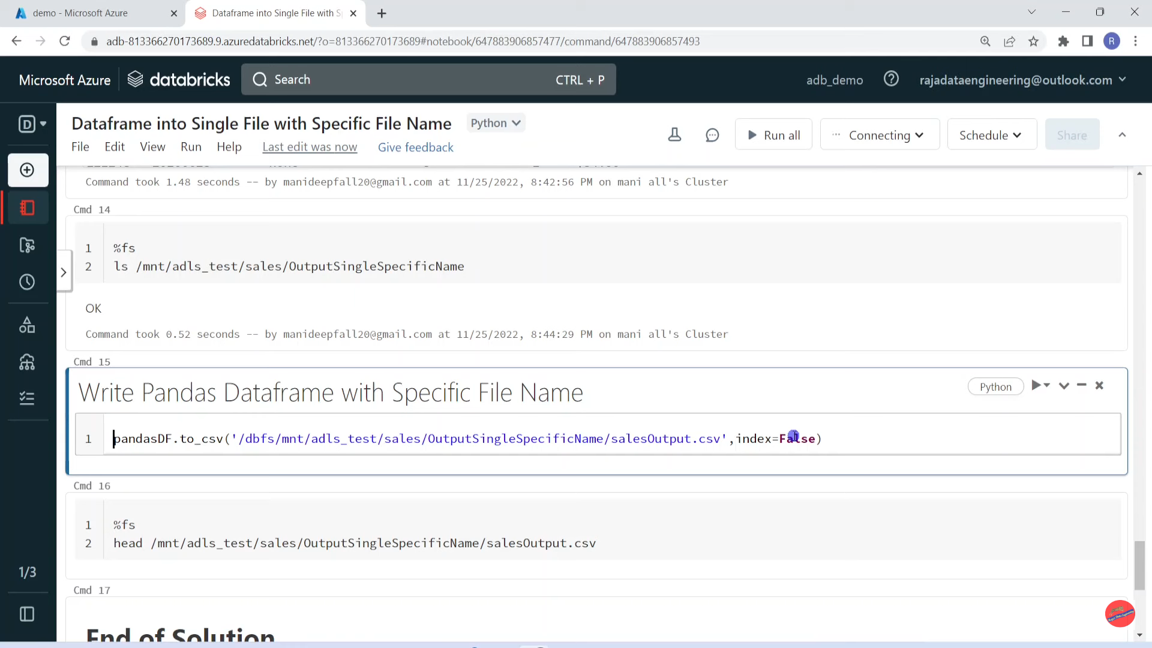

Slide 33
Pyspark | Workspace Object Access Control

Slide 34
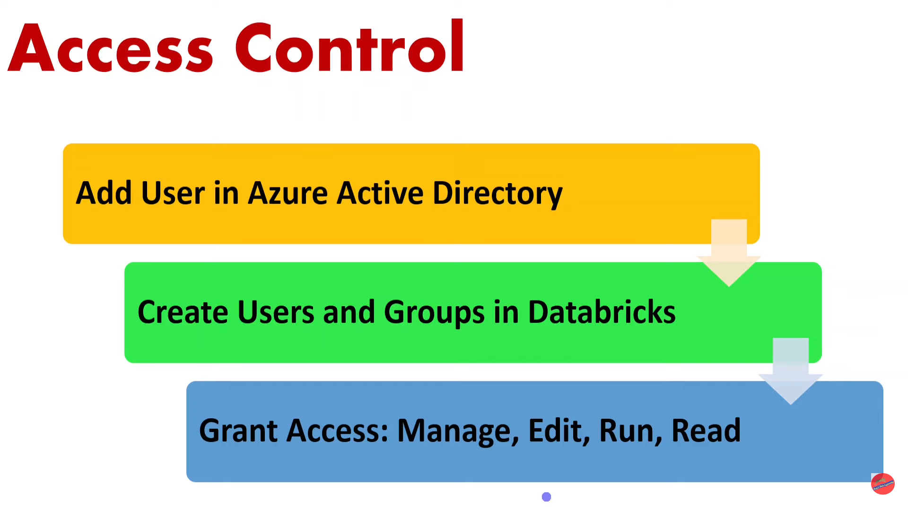

Slide 35
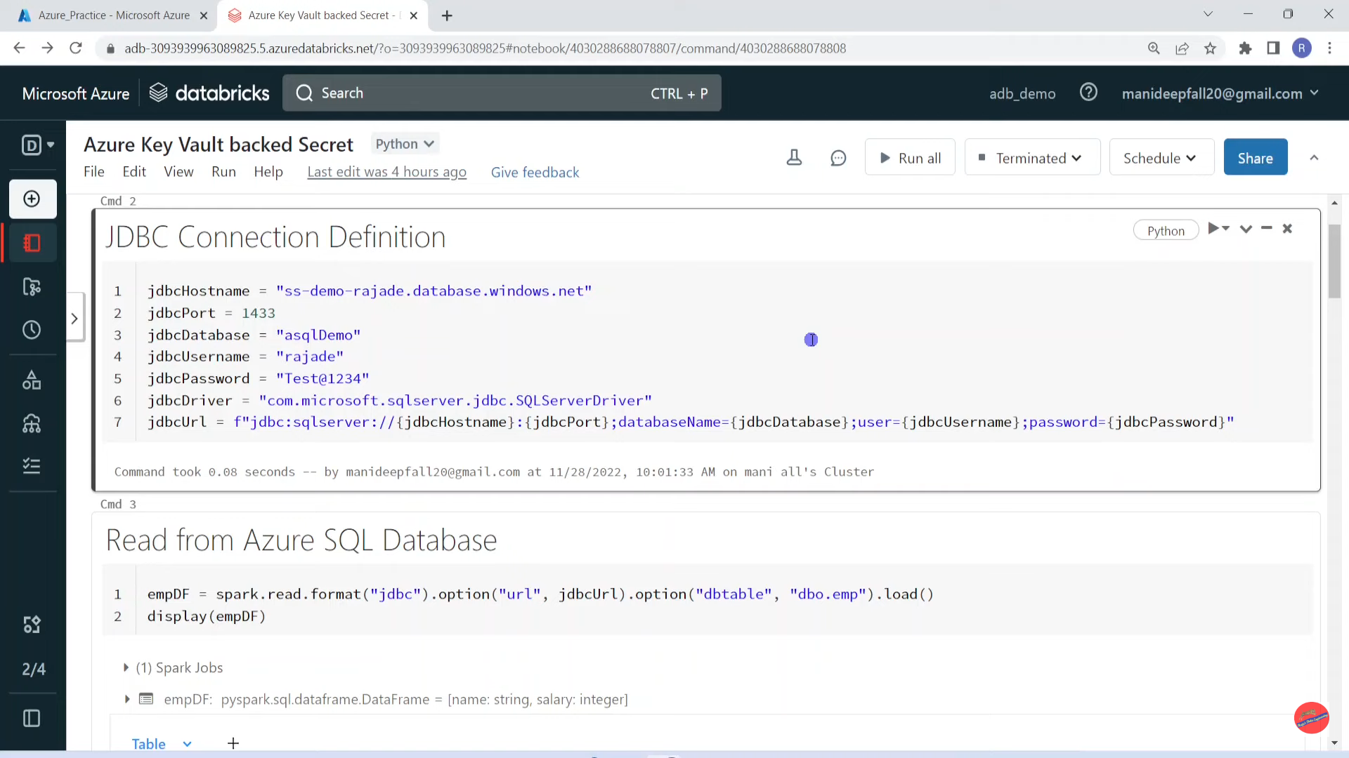

Slide 36
Databricks | Pyspark | Databricks Secret Scopes: Azure Key Vault Backed Secrets

Slide 37
What is Secret Scope?
Secret is collection of secrets which is needed for Databricks development
It prevents exposing sensitive details such as password, server name etc.,

Slide 38
Types of Secret Scopes
Azure Key Vault- backed scopes
Databricks- backed scopes

Slide 39
URL
• https://<databricks-instance>#sqcrets/createScope
• Secret Name
• Azure Key Vault DNS Name
• Azure Key Vault Resource ID

Slide 40
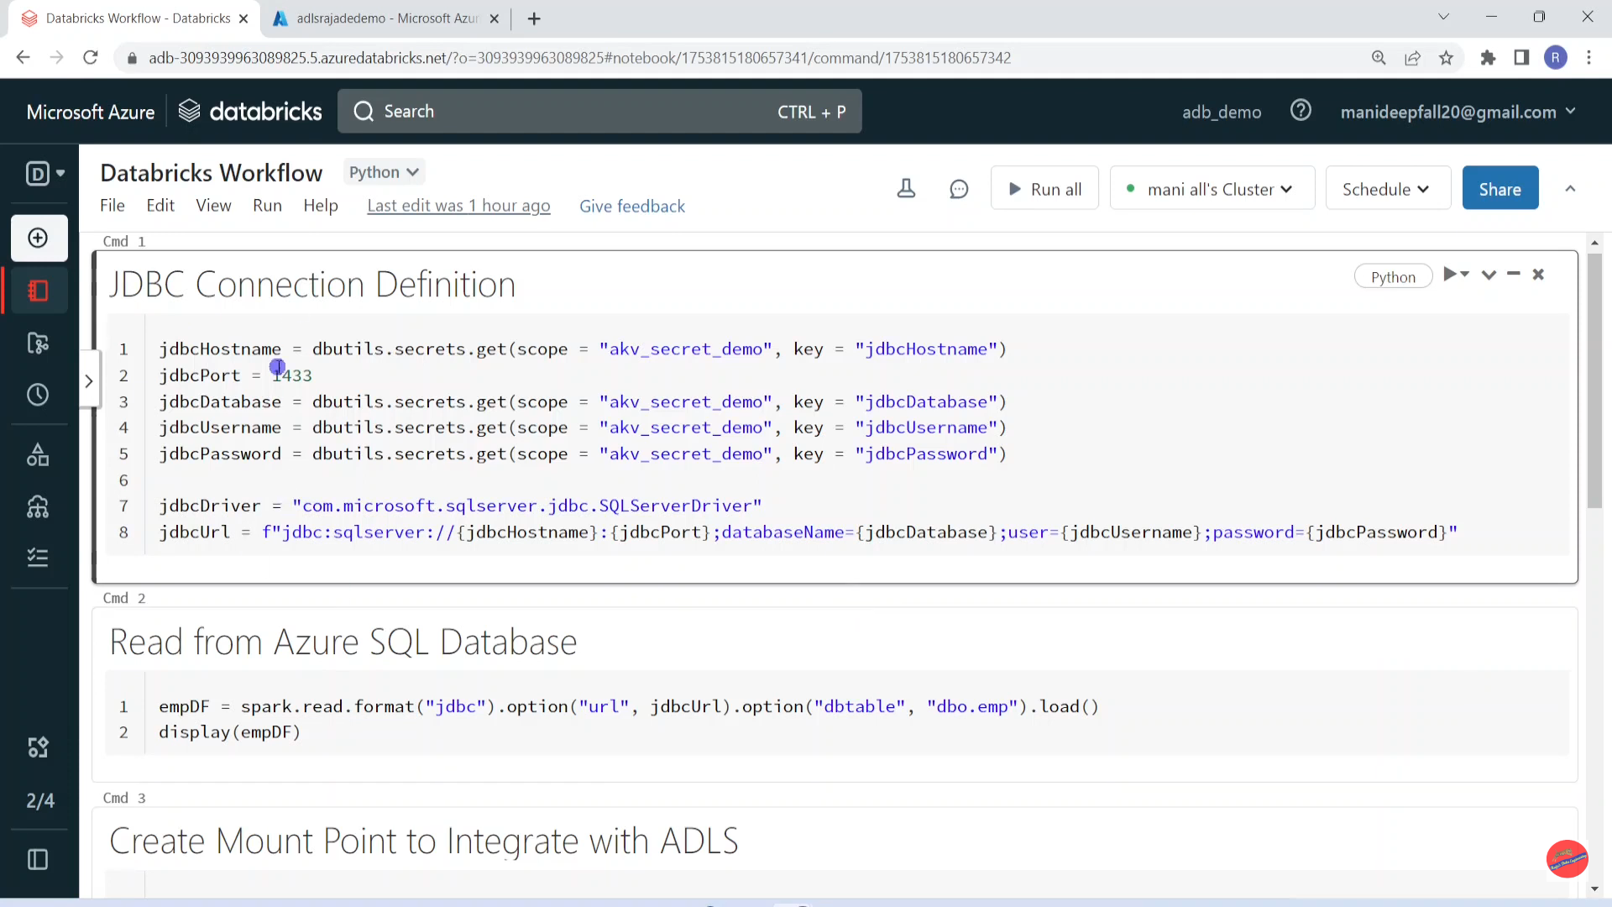

Slide 41
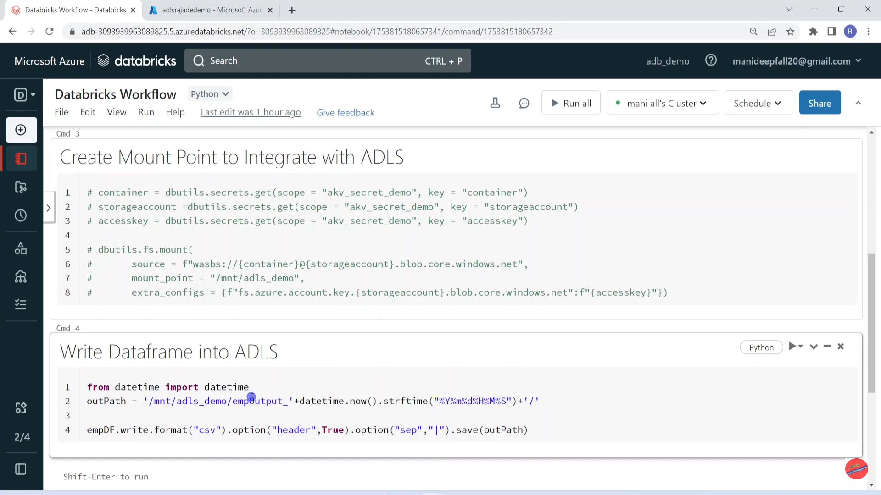

Slide 42
Pyspark | Azure Data Factory + Azure Databricks: Execute Notebook Via ADF

Slide 43
What is ADF?
Build ETL Pipelines
Schedule Pipelines
Orchestration Tool

Slide 44
ADF Trigger
Only for Databricks Notebooks
ADF: Integrate Many Services
Databricks Workflow

Slide 45
Components
ADB Notebook
Output Parameters
Input Parameters
ADF Linked Service
Cluster Selection

Slide 46
Pyspark | Notebook Activity in Azure Data Factory with Input Parameter

Slide 47
What is Widget in Databricks
Input
Drop Down
Combo
Text

Slide 48
Why Data Security is Important?
Data Security
Maintaining trust with customers
Compliance with regulations
Preventing data breaches
Protecting sensitive information

Slide 49
Databricks Security Features
Encryption at Transit/Rest
RBAC
Multi-Factor Authentication
Audit Logging

Slide 50
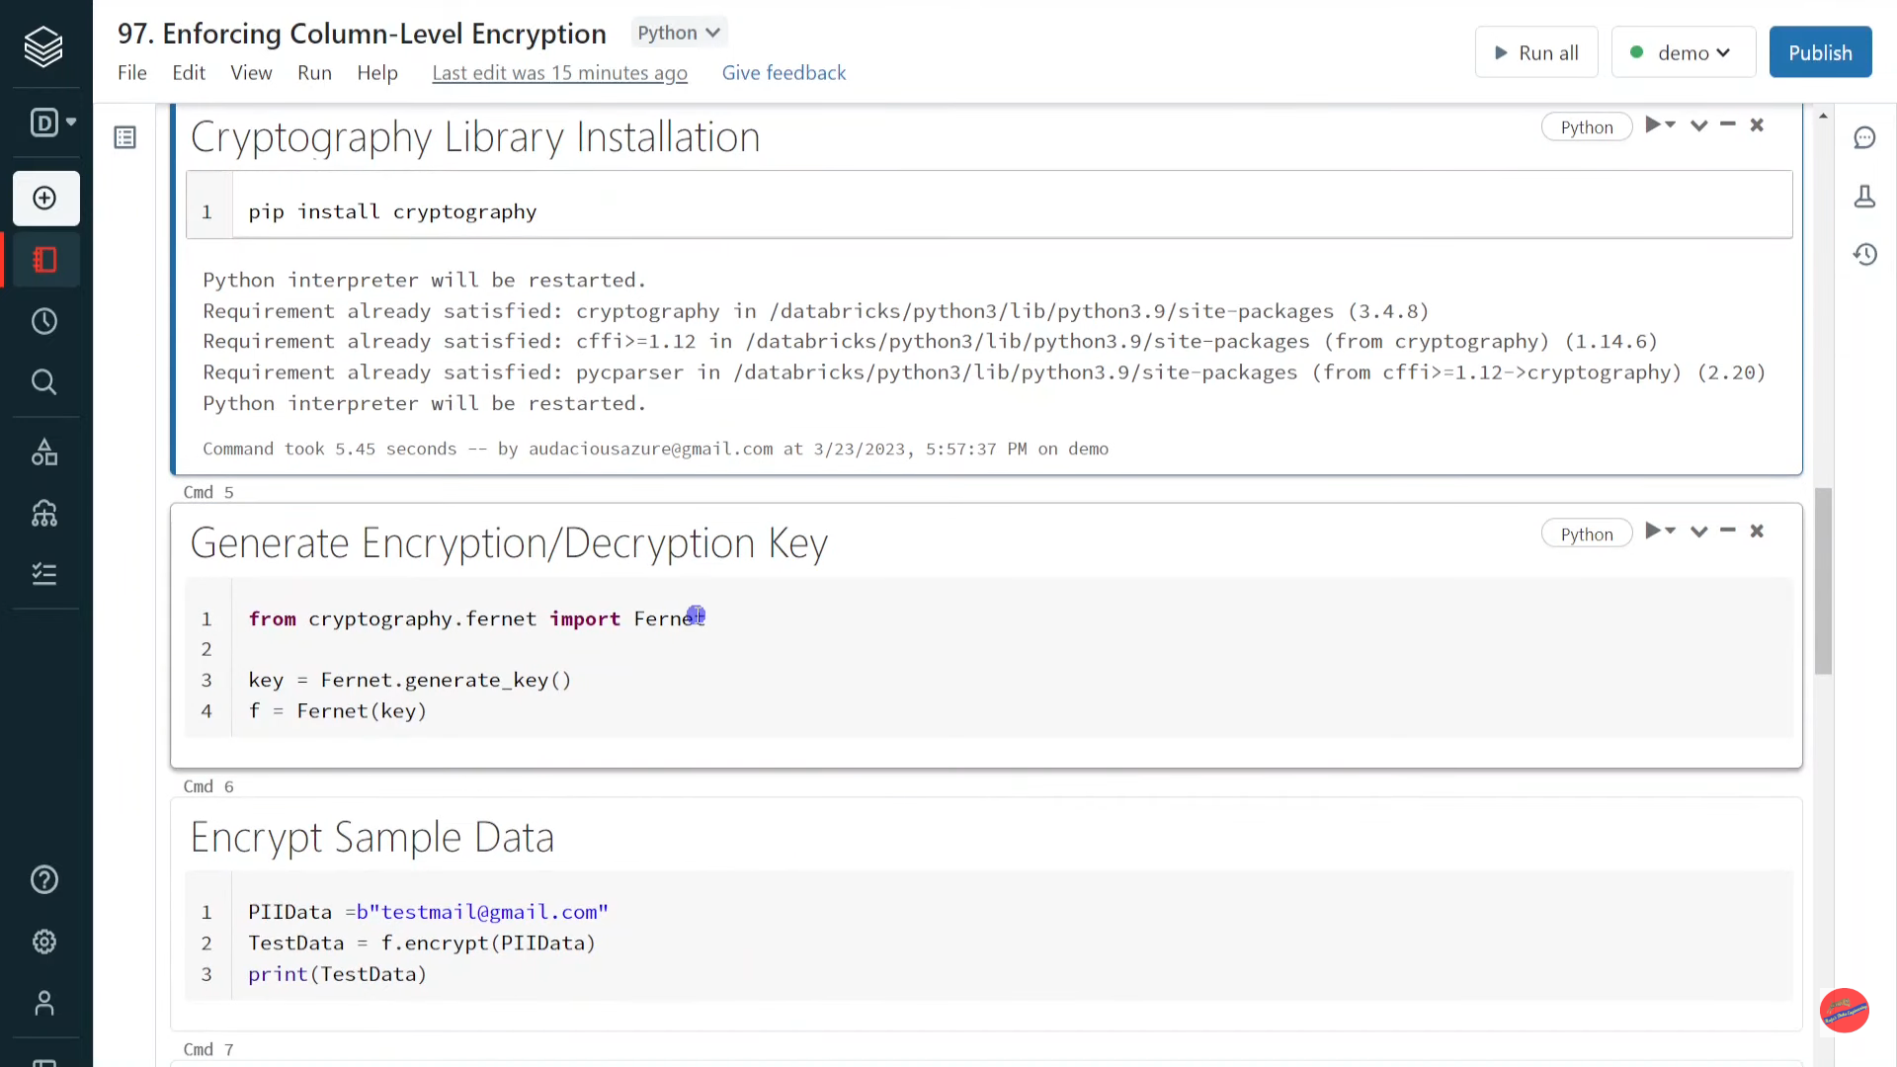

Slide 51
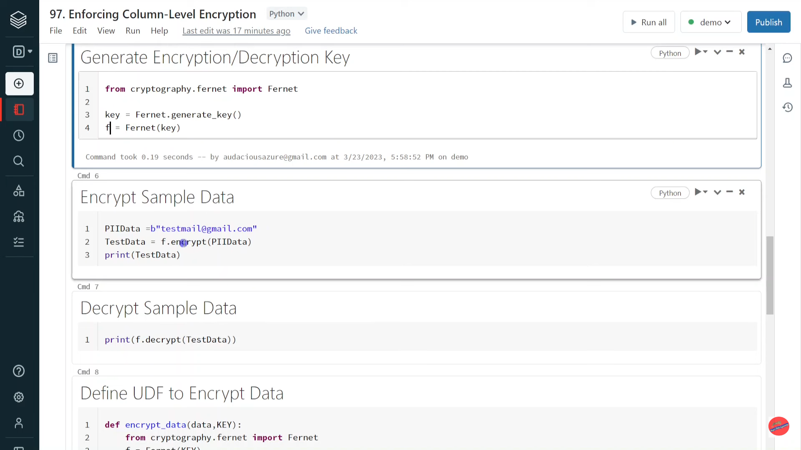

Slide 52
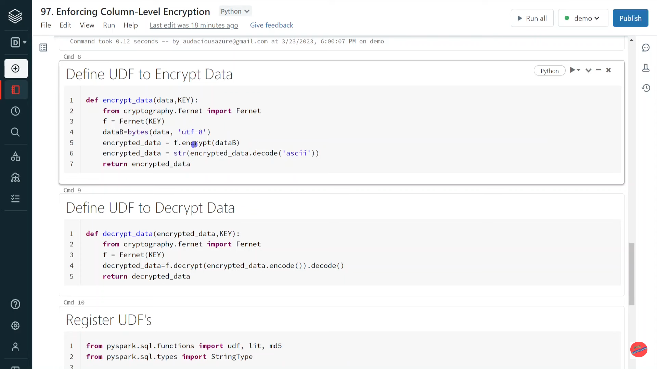

Slide 53
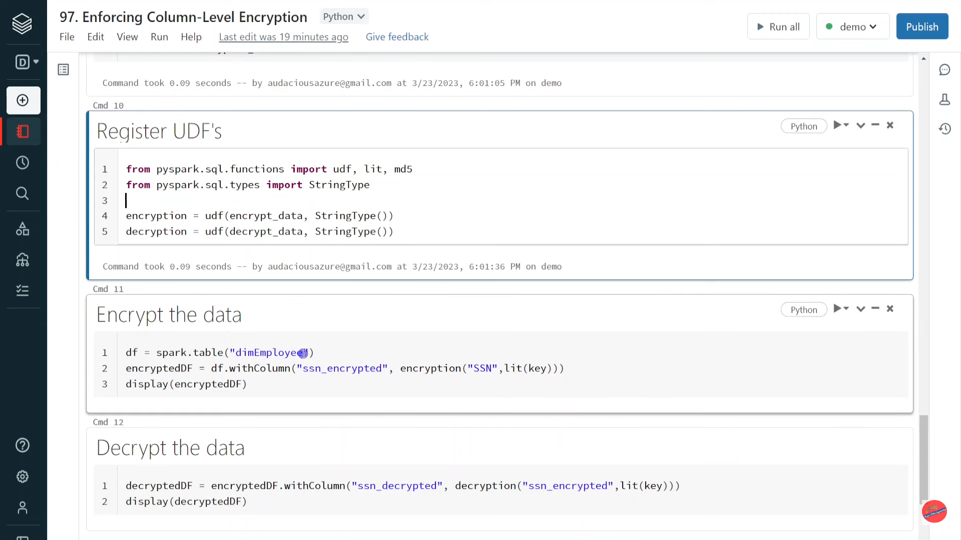

Slide 54
Databricks | Pyspark | Interview Question: Pyspark VS Pandas

Slide 55
What is Pandas?
Pandas is an open-source Python library that provides high-performance data
manipulation and analysis tools.
It is built on top of NumPy and provides easy-to-use data structures such as Seric
(I-dimensional labelled array) and DataFrame (2-dimensional labelled table) for
working with structured data.
Pandas is widely used in data science and machine learning projects for
data cleaning, data exploration, data analysis, and data visualization.

Slide 56
What is PySpark?
PySpark is the Python API for Apache Spark, an open-source distributed
computing system used for big data processing and analytics.
It provides a high-level interface for programming Spark with Python,
enabling data scientists and engineers to write distributed data processing
code in Python.
PySpark allows users to leverage the power of Spark's distributed computing
engine for data processing, machine learning, and analytics tasks.

Slide 57
PySpark
PySpark is python library for spark which is written in Scala and runs on the Java Virtual Machine (JVM, immutable in nature
PySpark DataFrame is designed to work with distributed data processing on a cluster This means that Spark DataFrame can handle much larger datasets than Pandas
PySpark allows parallel processing of data
Spark DataFrame can read and write data from a wide range of data sources, including Hadoop Distributed File System (HDFS), Apache Cassandra, Apache HBase, Amazon S3, and more
PySpark DataFrame uses lazy evaluation. This can improve performance by minimizing the amount of data transferred Between node in a distributed system.
Pandas
pandas is written in Python, mutable in nature
pandas is a library for working with smaller, tabular or series datasets on a single node processing.
Pandas does not support parallel processing
pandas is limited to reading data from local file systems.
Pandas DataFrame, on the other hand, eagerly evaluates all operations on data

Slide 58
Pyspark | Real Time Use Case: Generate Test Data - Array_Repeat()

Slide 59
What is Array _ repeat
Creates an array containing a value (from a column) repeated count times

Slide 60
Pyspark | Spark Architecture: Internals of Partition Creation Demystified

Slide 61
Spark Partitions Mystery
Internal
Mechanism
Number of
partition
calculation
Partitions

Slide 62
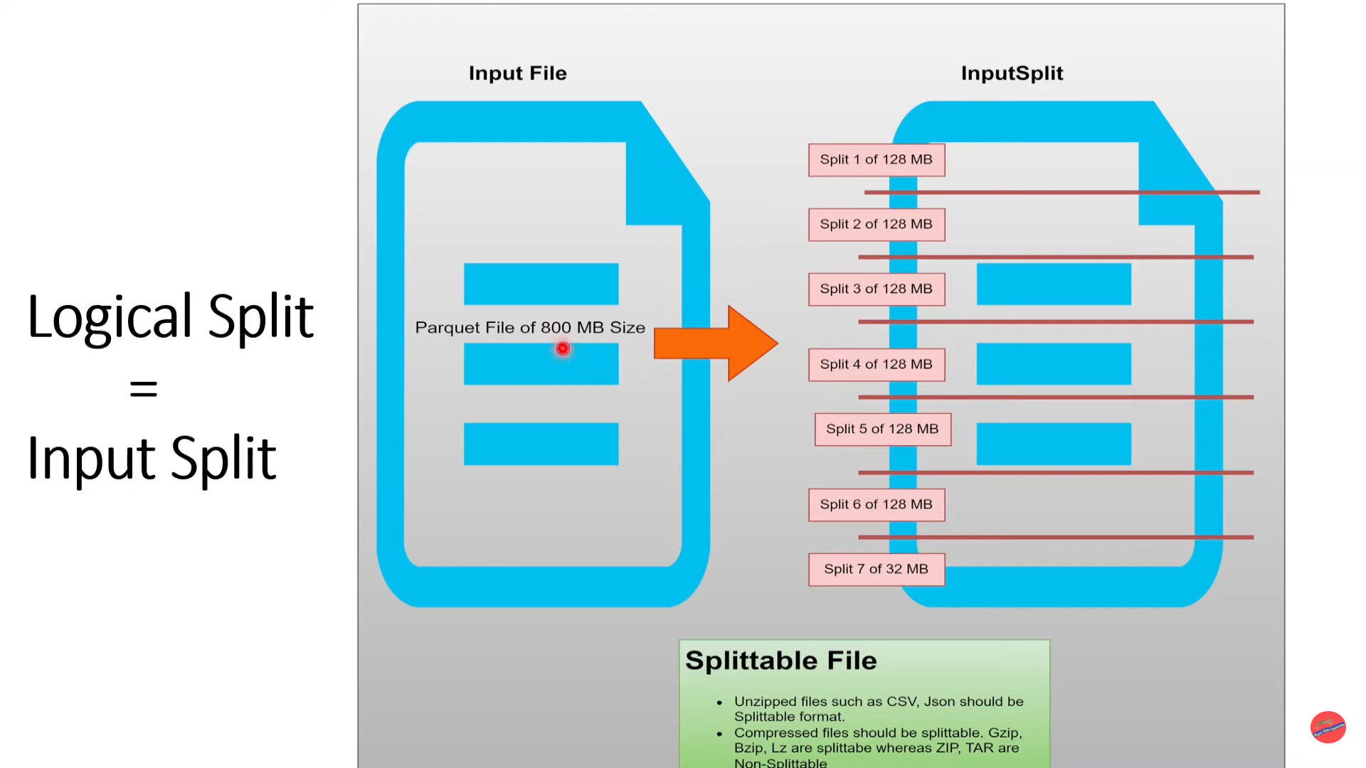

Slide 63
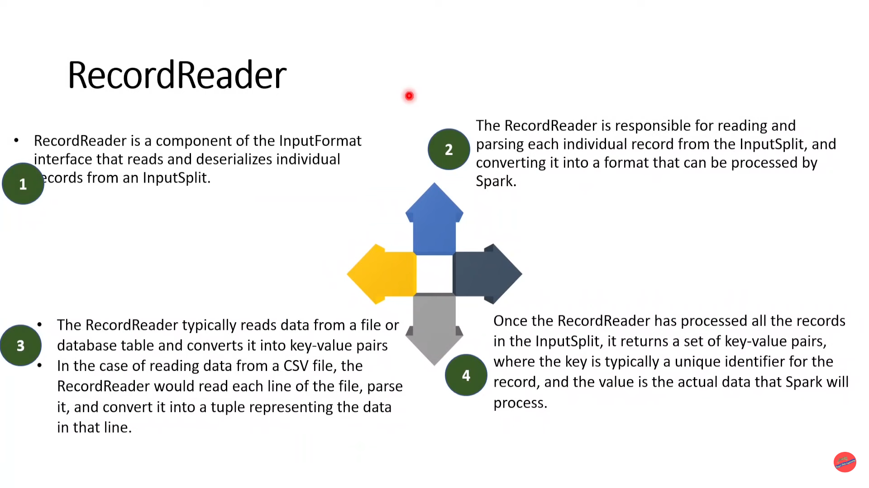

Slide 64
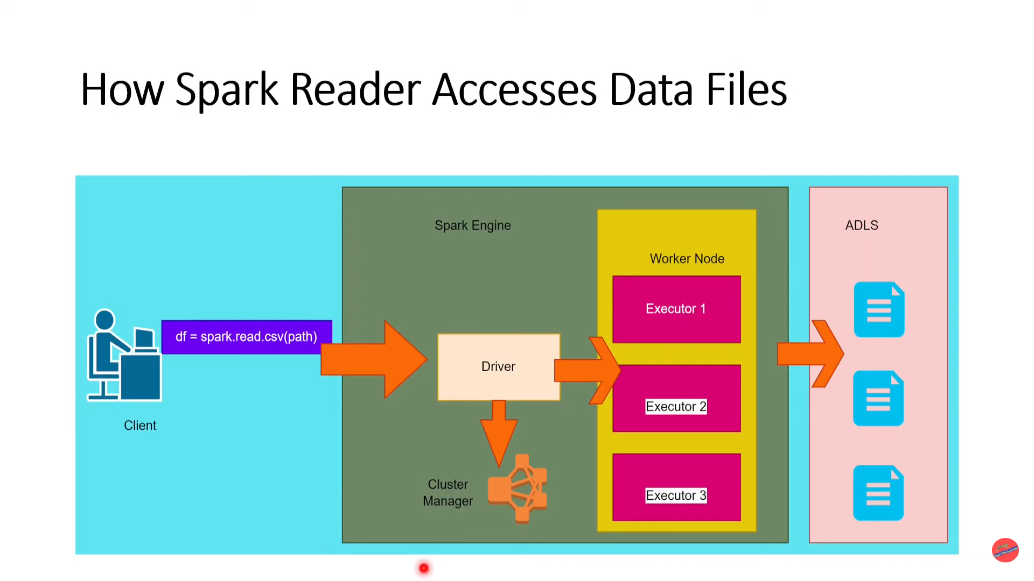

Slide 65
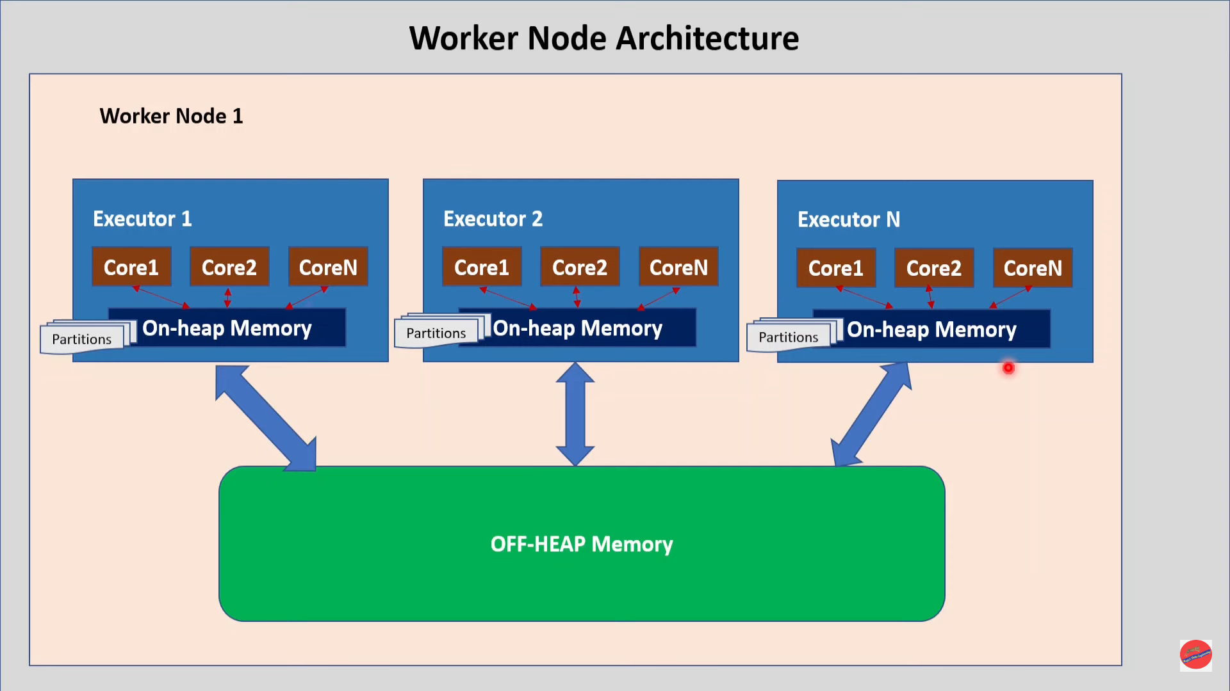

Slide 66
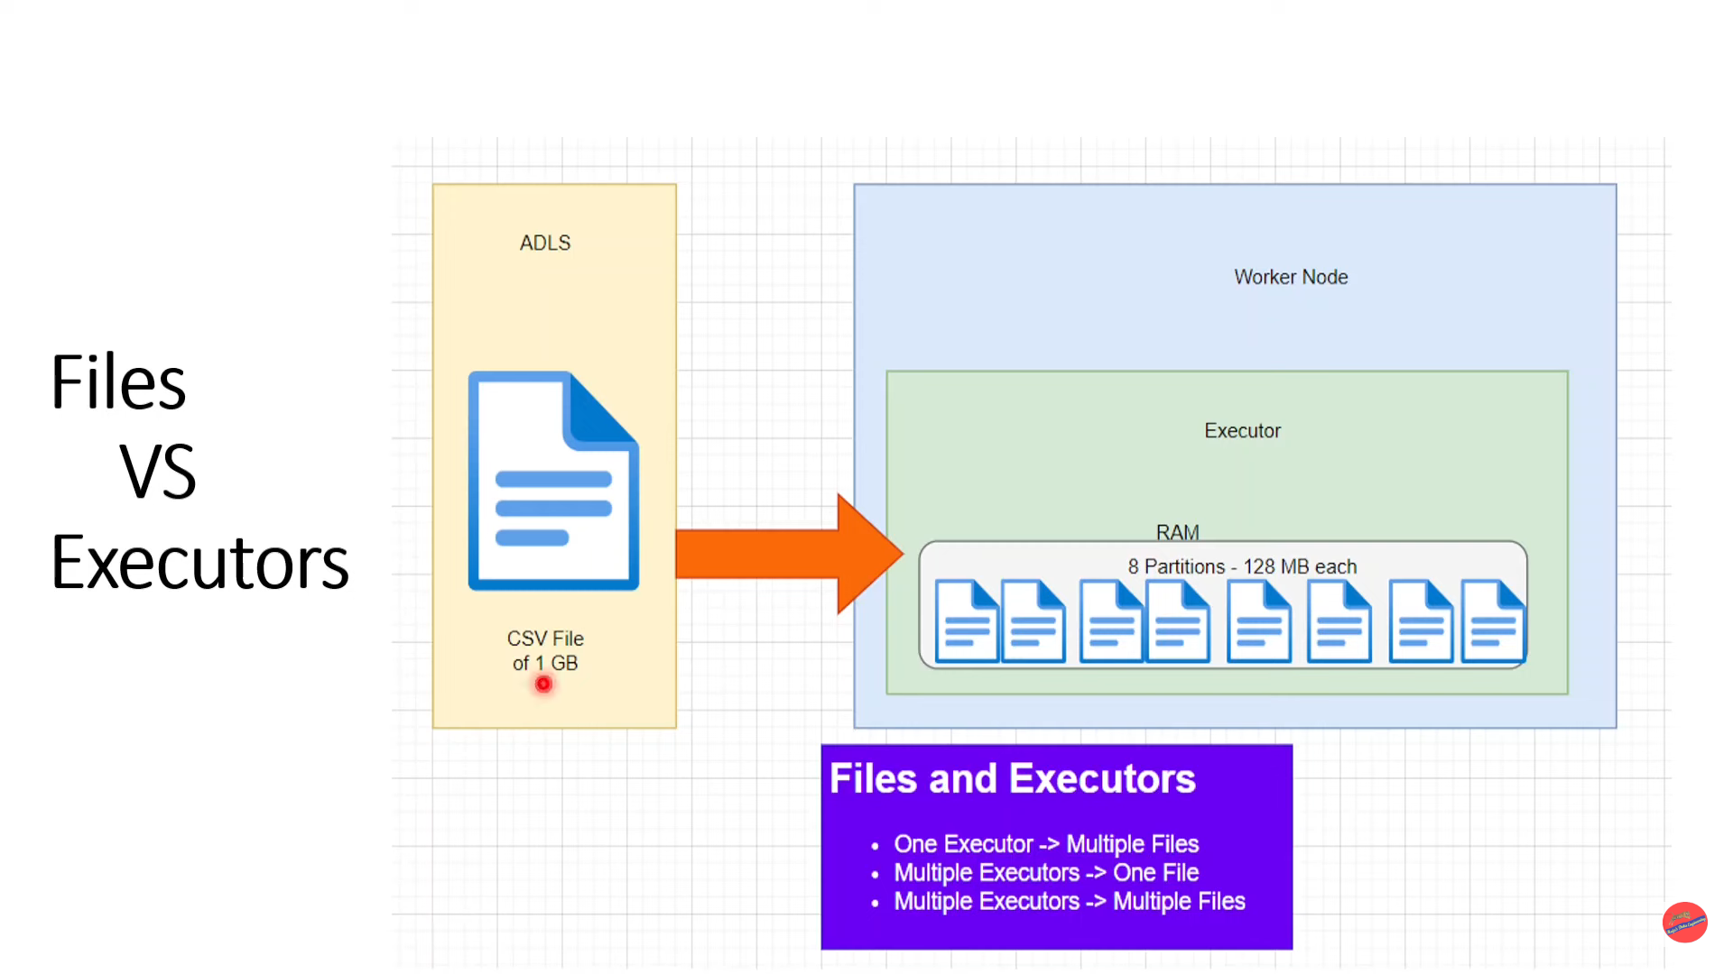

Slide 67
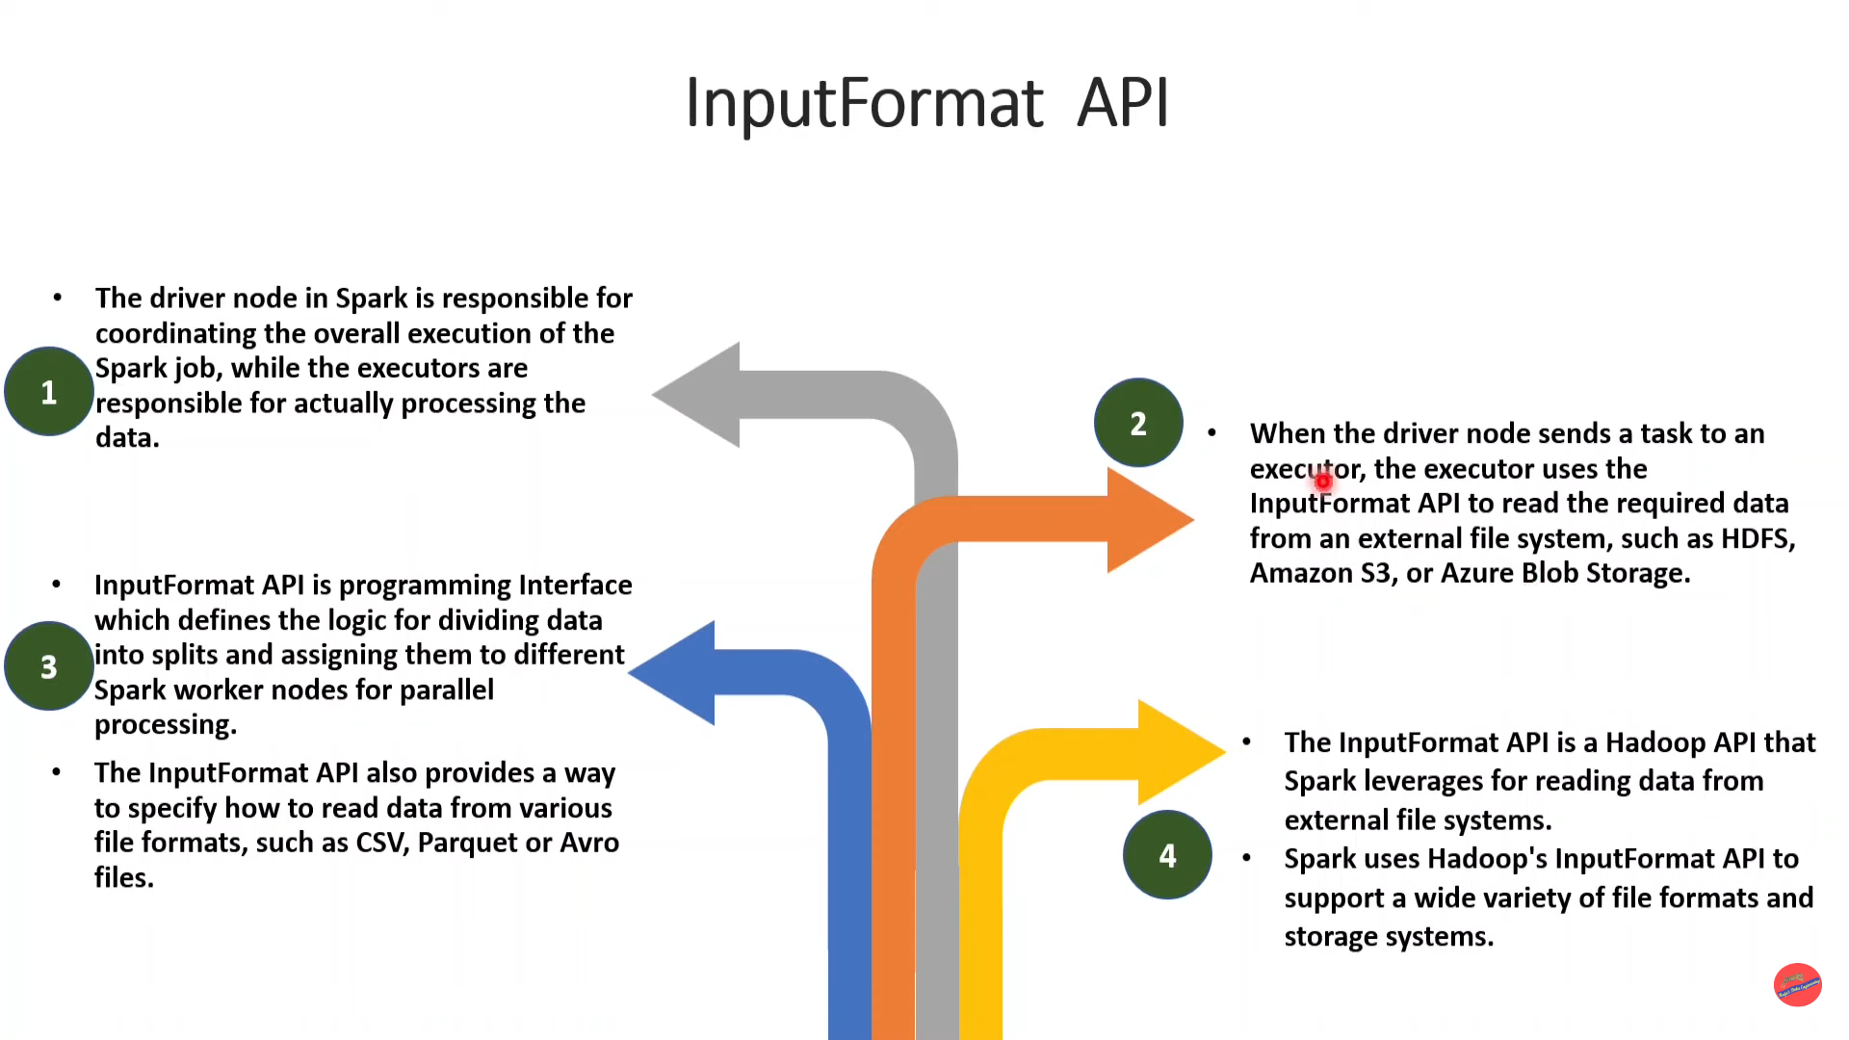

Slide 68
FilelnputFormat
FilelnputFormat is ? class in the Hadoop InputFormat API, which is used in Apache Spark for reading data from files in Hadoop Distributed File System (HDFS) or other file systems.
FilelnputFormat class is used as the base class for all file-based input formats, such as TextlnputFormat, SequenceFilelnputFormat, AvrolnputFormat, etc.
It provides methods to read and split input data from files into smaller partitions, processed in parallel across a Spark cluster

Slide 69
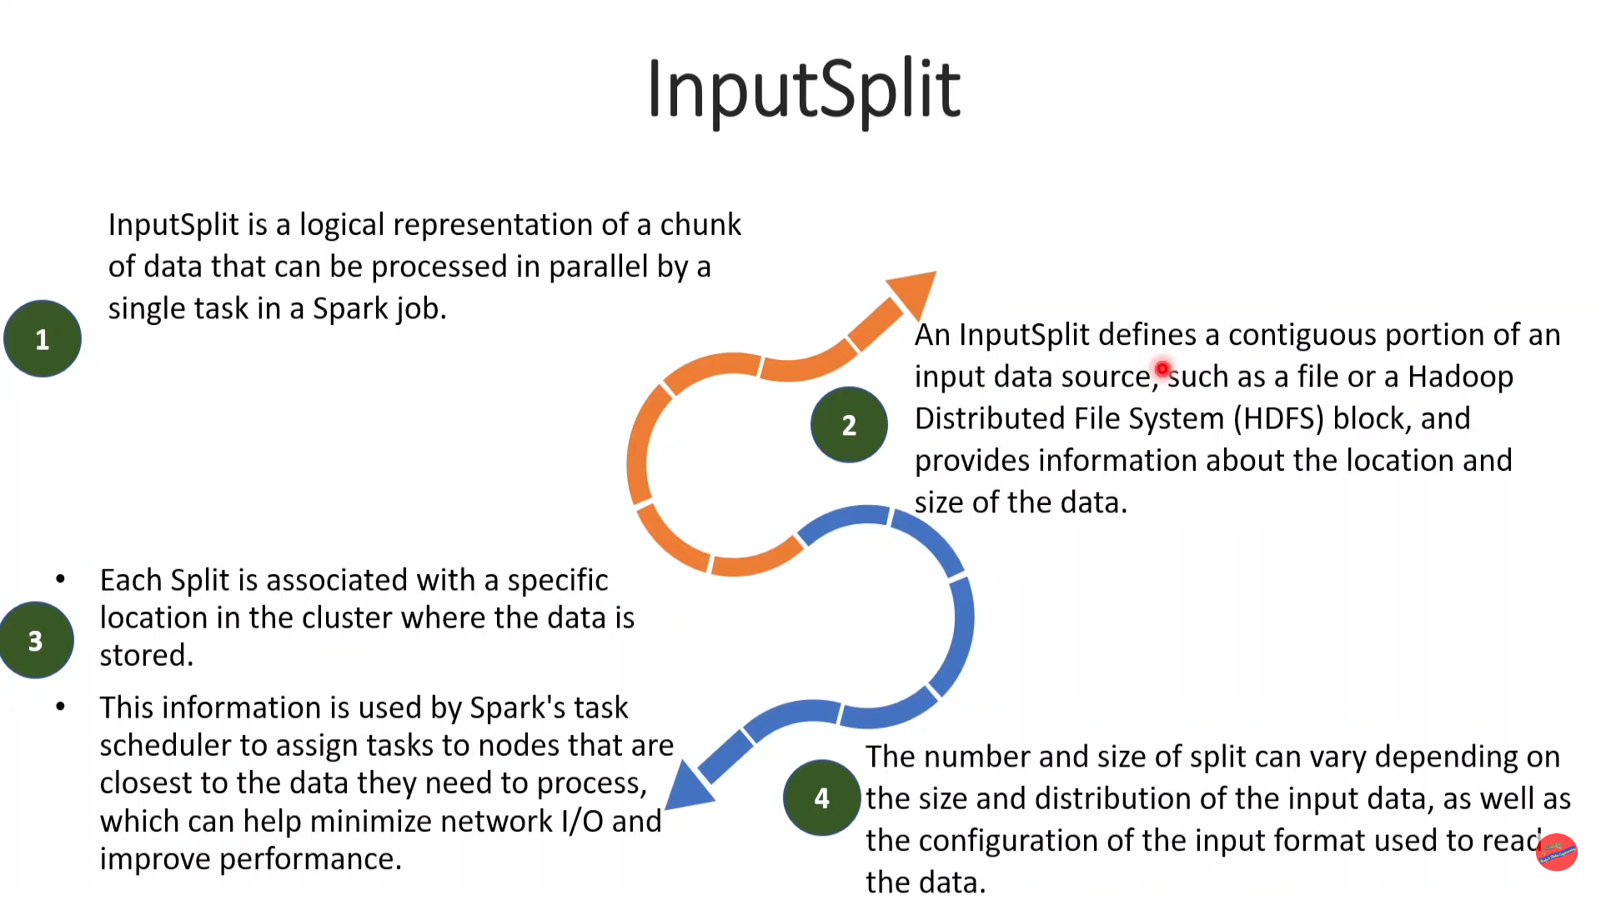

Slide 70
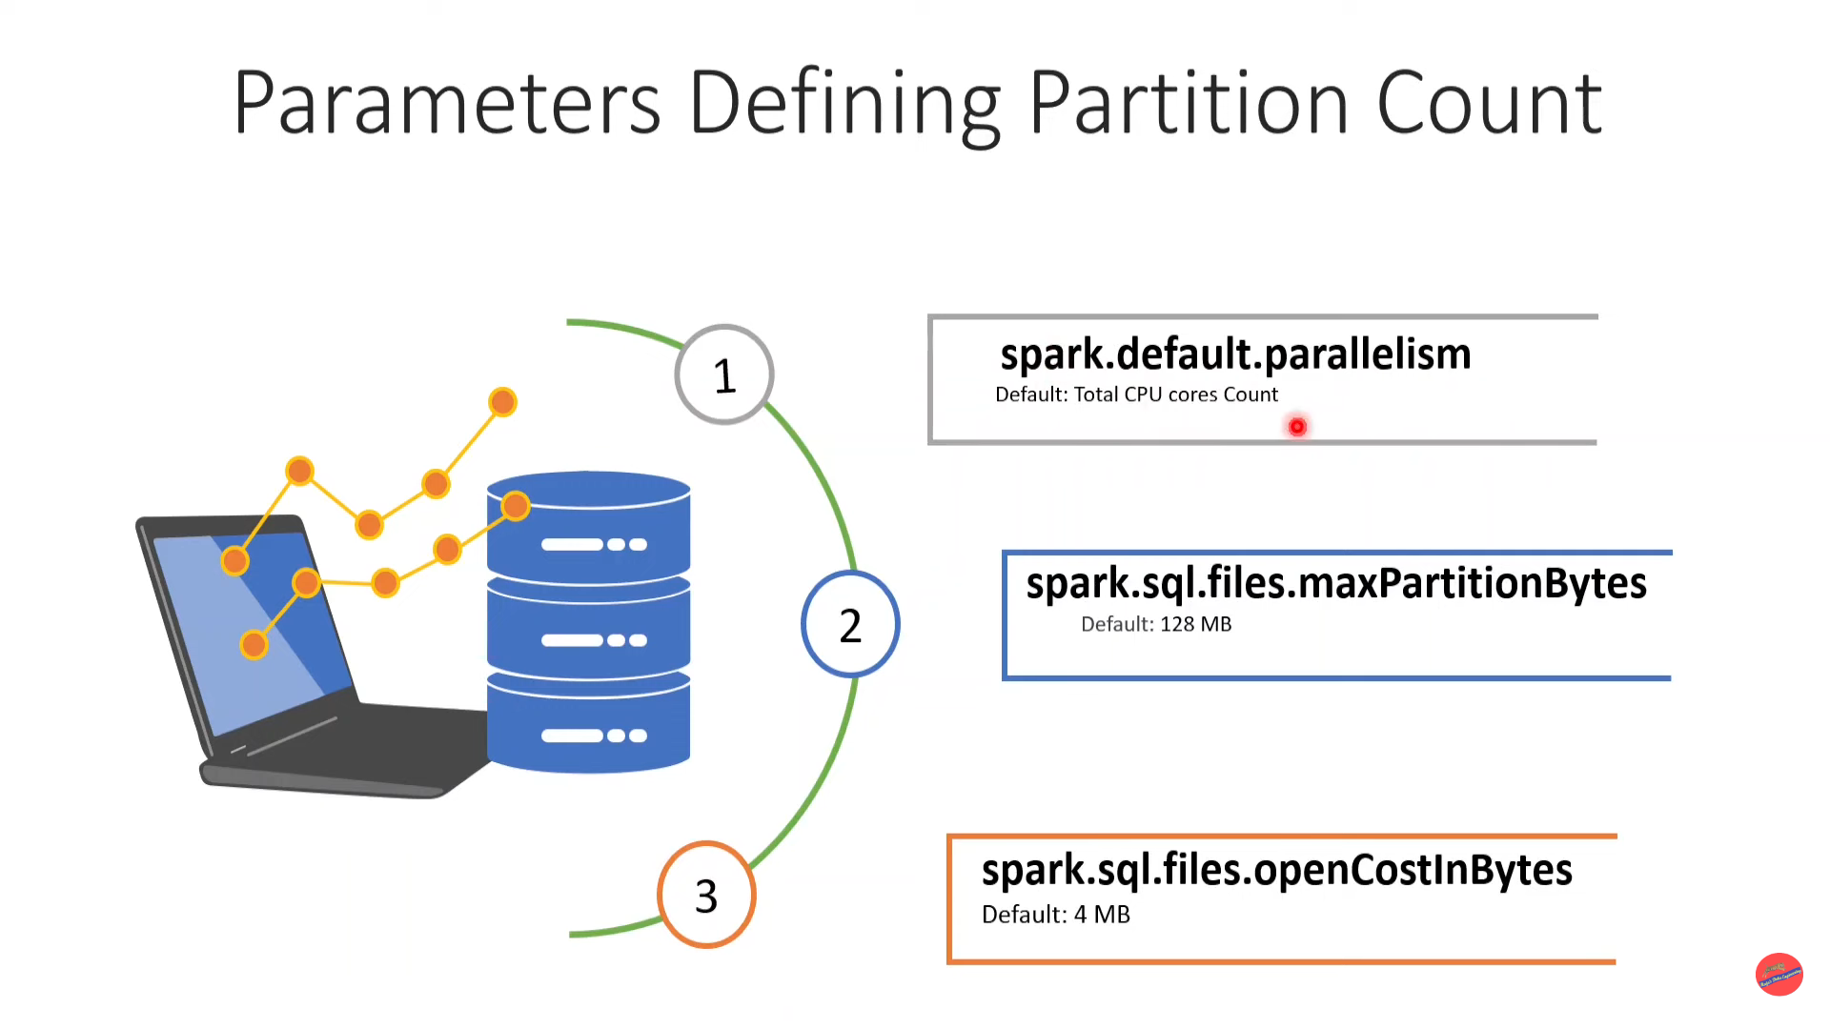

Slide 71
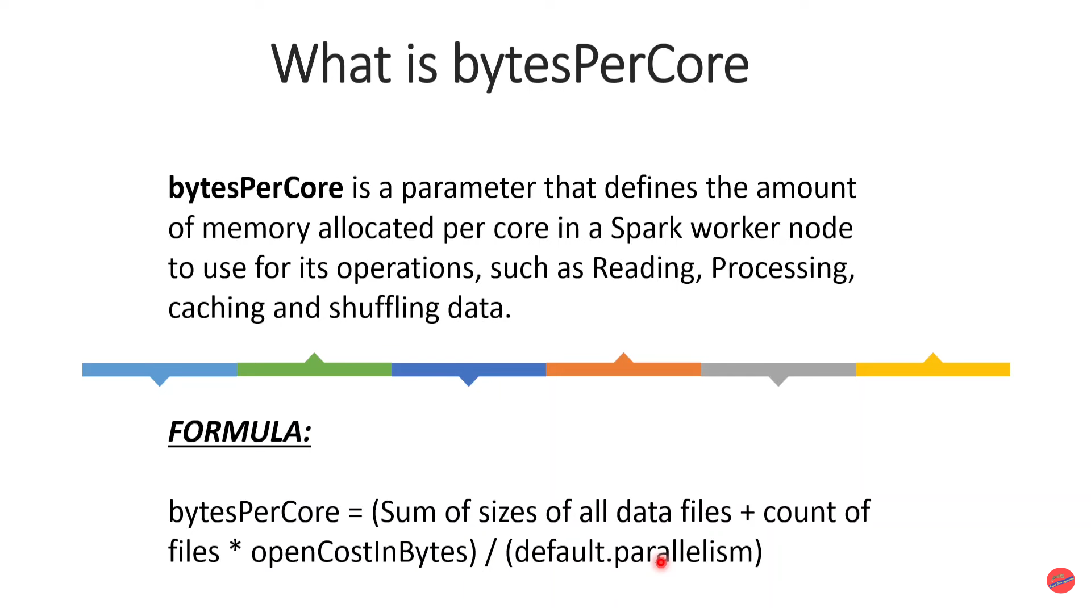

Slide 72
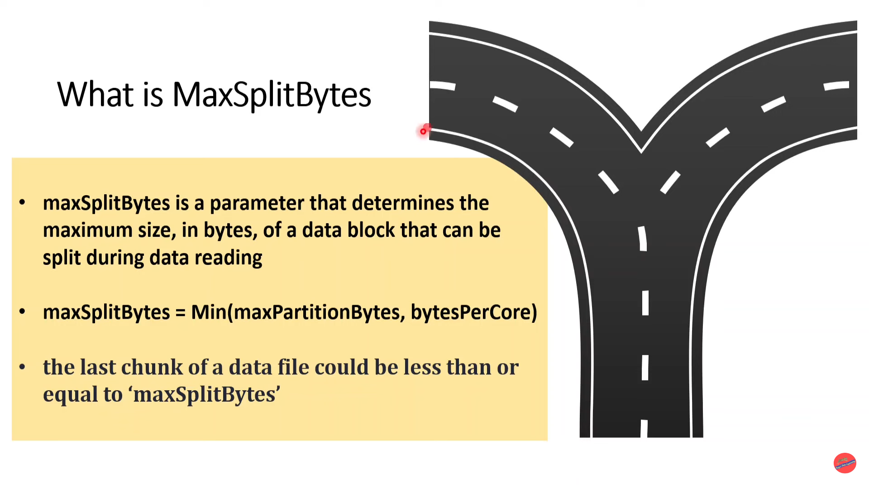

Slide 73
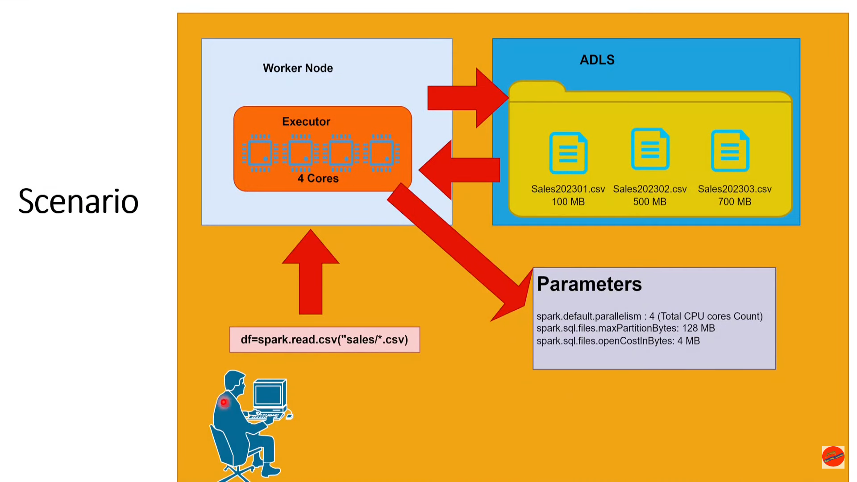

Slide 74
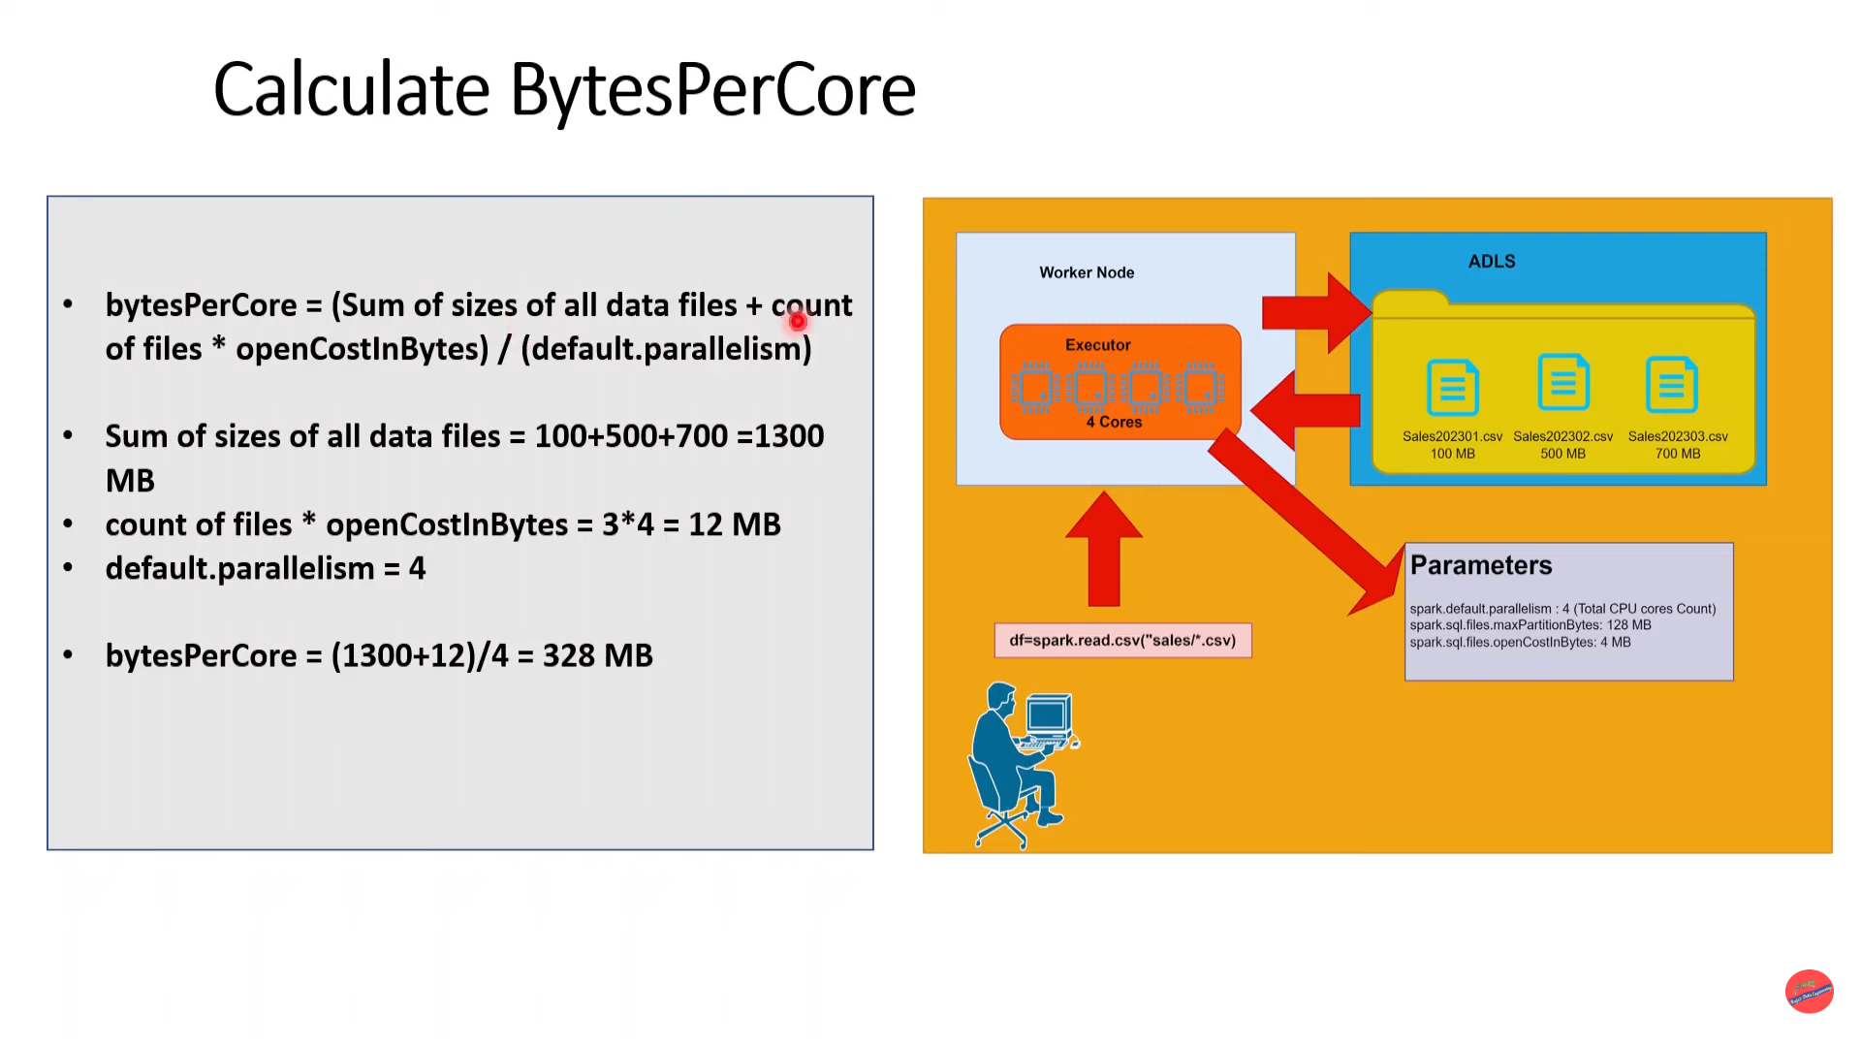

Slide 75
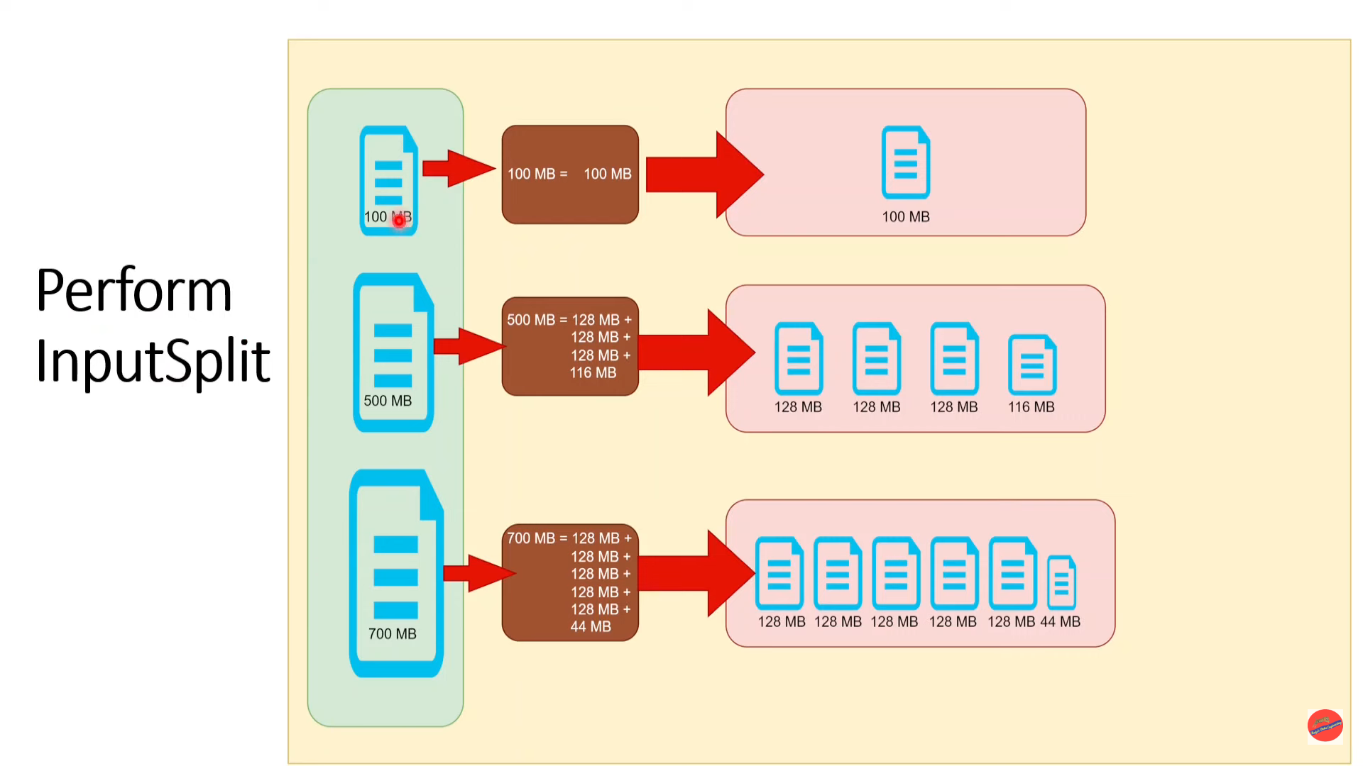

Slide 76
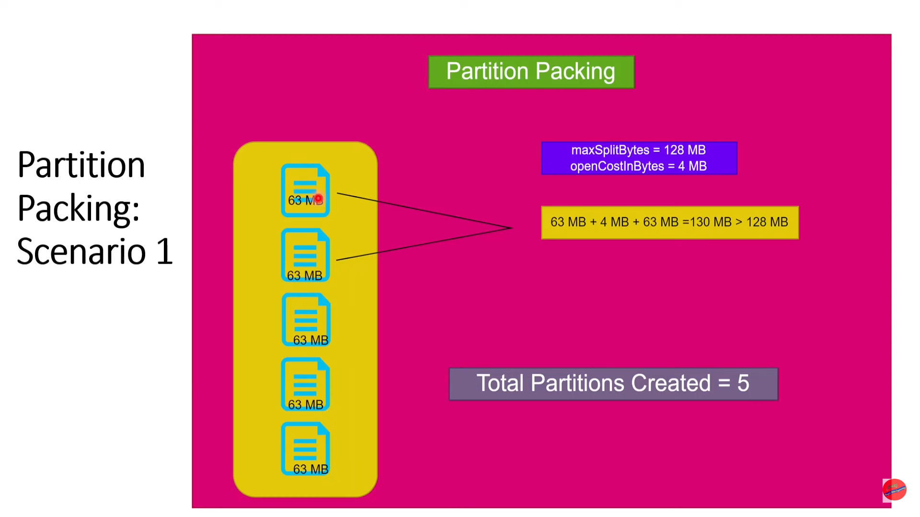

Slide 77
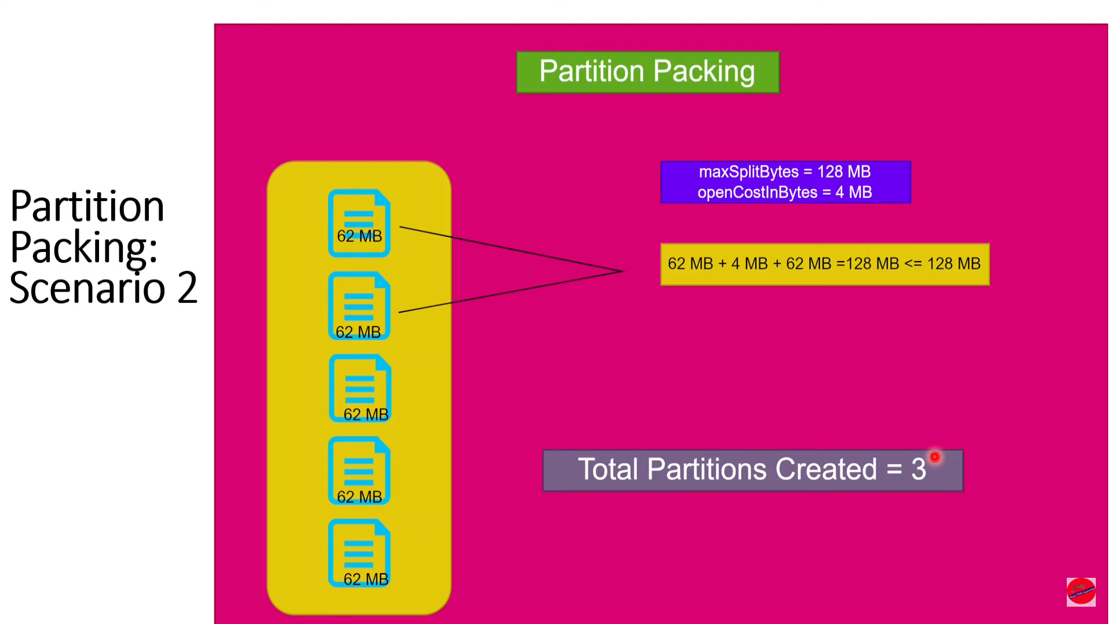

Slide 78
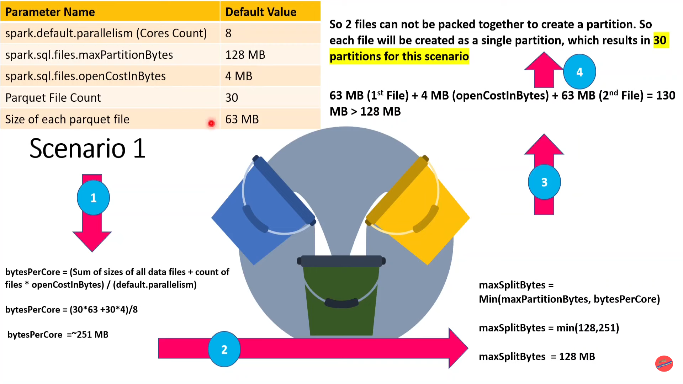

Slide 79
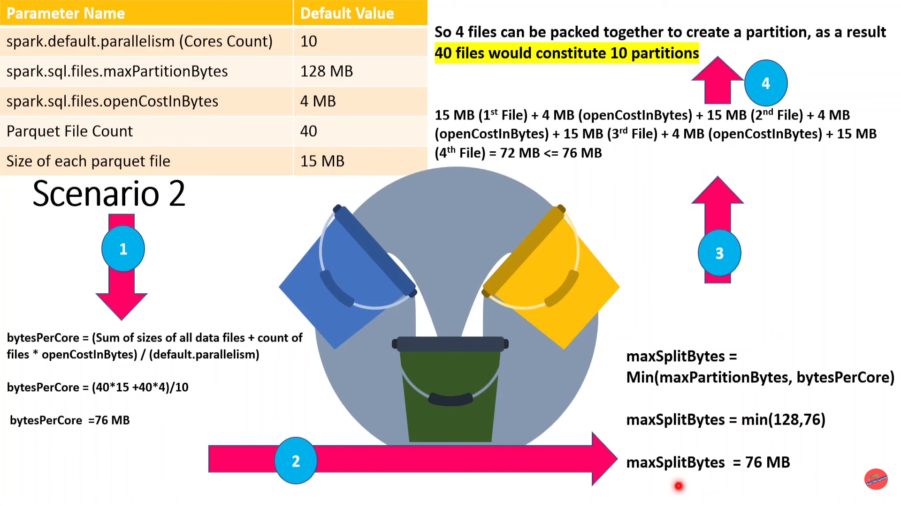

Slide 80
